Slide 1
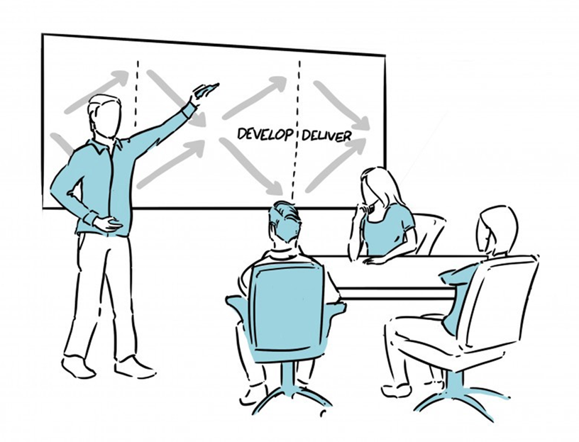
“Service design approach in the development of nursing services” Lecture 01 “Service design methodology and process ”
johanna heikkilä, Senior Advisor,
PhD in NursIng Science,
Docent in Clinical Caring sciences
JAMK UniversiTY OF APPLIED SCIENCES, FinLAND

Slide 2
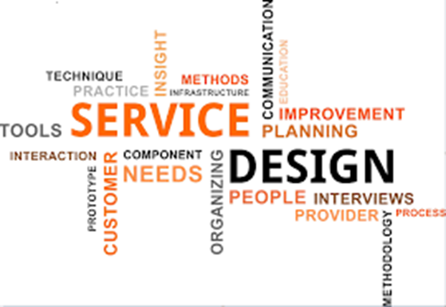
Service design
- is the activity of planning and implementing change to improve a service’s quality. (Fry 2019)
- focuses on holistic service experiences to fully understand the target group, users and context as completely as possible
- is a usercentric approach by including service providers, end-users and stakeholders in the design process. Users are seen as a resource and an integral part of the innovation process.(Fry 2019)
- is an interdisciplinary approach, that uses methods of various fields to improve services. (Fry 2019)
-offers a unique approach in the sense that it includes service-providers, customers and managers into not only the implementation of the suggested improvement, but also the development of it (Fry 2019)
- can be used for development of person cented-care, identification of current problems for improved pathway design and new service delivery. (Simonse et al 2019)

Slide 3
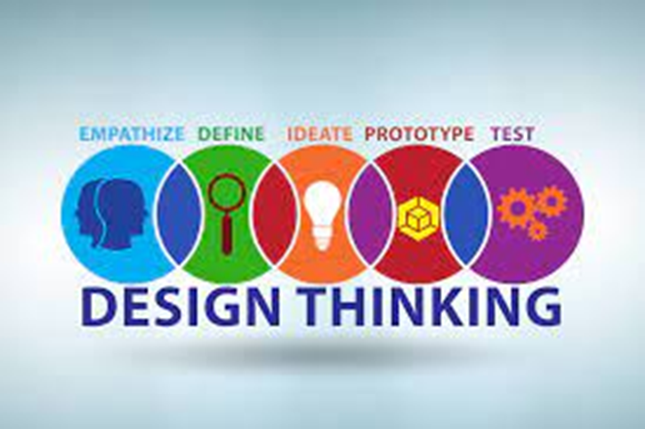
Design thinking as approach in service design
Design thinking has been defined as an “analytic and creative process that engages a person in opportunities to experiment, create and prototype models, gather feedback, and redesign”.(Razzouk & Shute 2012)
Design thinking has been described as a “systematic innovation process that prioritizes deep empathy for end-user desires, needs and challenges to fully understand a problem in the hopes of developing more comprehensive and effective solutions”.(Roberts et al 2016)

Slide 4
Comparison of Design thinking and Process improvement (Roberts et al 2016)
Process improvement orientation
Design thinking orientation
Prioritizes evaluation of limited set of possible solutions
Well suited to address problems that have predictable solutions
Promotes consensus building (convergent)
Aims to uncover what is important to consumers within a particular experience
Empathy research focuses on what people think to reveal improved outcomes
Prioritizes comprehensive understanding of underlying problems
Well suited to address problems that have unpredictable solutions (wicked problems)
Promotes opposing ideas and debate (divergent)
Aims to uncover what is important to consumers in their everyday lives
Empathy research focuses on what people feel to reveal new/disruptive outcomes

Slide 5
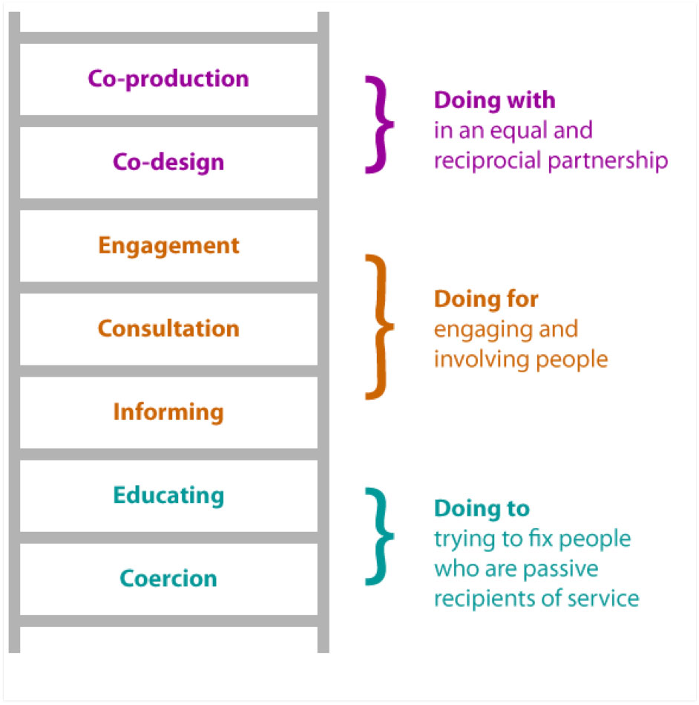
Ladder of Co-production
The Ladder of Co-production was produced by the National Co-production Advisory Group at Think Local Act Personal (TLAP), building on previous work by Sherry Arnstein (1969)

Slide 6
Central pillars of service design (Fry 2019)
User-centric
Co-creation
Iterative process
Visual communication
Holistic services

Slide 7
Central pillars of service design (Fry 2019) 1/3
User-centric
Co-creation
By placing the user in the centre of the service, service designers are able to discover how the user experiences the service in its wider context to understand users’ true motivations, social context and habits.
Requires a deeper understanding of users than statistical descriptions, thus service design uses empathic approaches like interviews, observation and field research.
Involving stakeholders not only in the design of the solution but also in the production and development of it.
Done in multidisciplinary teams, as without the deep expertise of various relevant specialists, the knowledge and skills in the service design team would be very shallow.
A partnership between the professional groups, as well as patients, where they work together and everyone has the opportunity to input their perspectives and experiences on level terms. During the process of co-design where everyone is given the opportunity express themselves.
Brings groups together and thus creates a feeling of ownership for the innovation being created. Staffs’ engagement and motivation is crucial for a sustainable service implementation.

Slide 8
Central pillars of service design (Fry 2019) 2/3
Iterative process
Visual communication
It is not about avoiding mistakes, but rather exploring as many mistakes as possible and learning from them. This is often done by making prototypes or probes of products or services and testing them on end-users and stakeholders. As a designer, you can save the organisations time and money if you test the experience before resources are spent on actually developing it.
Service designers often use visual aids like sketches, pictures or prototypes to communicate.
Encouraging all stakeholders to express themselves more visually, can make ideas more tangible, less complex and supports the communication between the actors involved.
A clear communication between the stakeholders about the desired outcome is essential for the implementation stage.

Slide 9
Central pillars of service design (Fry 2019) 3/3
Holistic services
Holistic services are services that examine the whole user journey and consider each touch point of that service.
Service design methods like service blueprints, user journeys and scenarios investigates the holistic customer experience and touch points.
This involves not only designing the whole journey as it is experienced by the users including both tangible and intangible qualities.

Slide 10
Double Diamond Design Process
The Scottish Approach to Service Design (SAtSD) - gov.scot (www.gov.scot)

Slide 11
Double Diamond - Design Process (Dolan 2021)
1.Discover
2.Define
3.Develop
4.Deliver
What will we do to fully understand the problem and not proceed with assumptions?
How will we synthesize our findings to define our problem?
How will we generate many viabel ideas to solve the problem?
How will we build, launch, and test our chosen solution?
A comprehensive understanding of the problem to be solved
A clear definition of problem to be solved and key success factors
A comprehensive understanding of potential solutions to the problem
A clear description of the solution to delivered and iterated upon

Slide 12
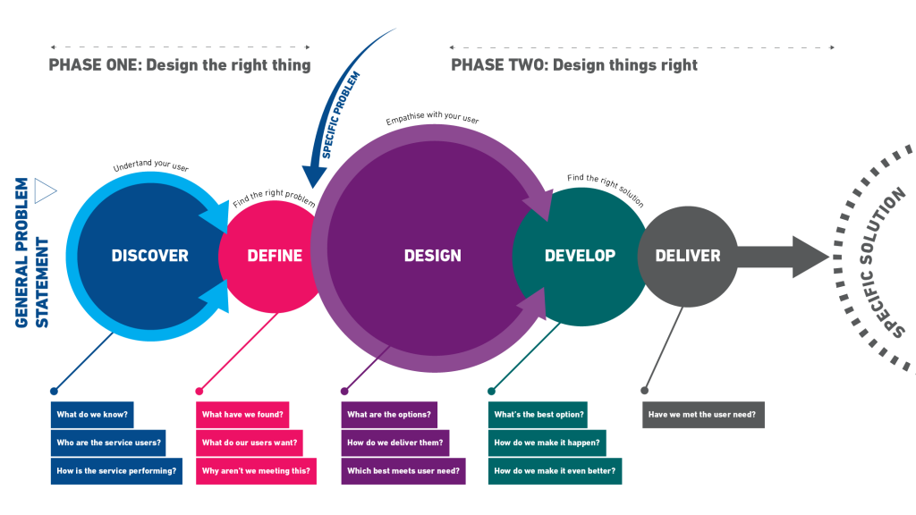
Service Design Model
1
3B
2
4
3A
(Moore 2020)

Slide 13
1. Discover phase
In the Discover phase we begin to identify the problem, opportunity or need to be addressed as well as define some of the boundaries of the solution space.
Objectives of discover phase
To learn directly from the people being designed for
Identify the problem, opportunity, or needs to be addressed
Define the solution space
Build a rich knowledge with inspiration and insights.
The discover phase is not:
Reinforcing existing ideas => The goal is to learn about users and the challenges they face, not to gather evidence to support a predefined solution.
Focused on solutions => Avoid making assumptions or thinking about solutions before the research is complete. Solutions come later in the process
Operating within an established scope => Be flexible. User research is an unpredictable process and often leads to unexpected insights. Use research even if it doesn’t align with expected findings, to show how far a problem might extend. (Moore 2021)

Slide 14
1. Discover phase
What should you do in the discover phase:
Identify services users
Gather research already done
Engage with users
Engage with stakeholders
Consider the current impacts on biodiversity and climate change
At the end of this stage of the review process you should have gathered enough data to understand the current service(s) from both an inside out and an outside in perspective.
(Moore 2021)
Notes:
What should you do in the discover phase:
1. Identify services users
You need to identify who are the services users and the best ways to engage with them – remember don’t just target people who currently engage with the service, think of everyone who might need the service. Users might not just be external customers; they could be internal staff or partners.
When engaging with users it’s important to speak with mainstream users and those on either extreme of the spectrum. For example, if designing an online form don’t just speak to residents who currently engage with online services also identify individuals who cannot or do not interact online at all. An idea that suits an extreme user is likely to work for the majority. It may be useful to liaise with organisations like Involve if there are certain demographics of people you want to target, as they are often involved in forums and activities with different groups.
2. Gather research already done
There’s lots of information you can already use. Make sure you’re checking for other local authority projects on sites like Pipeline or LGA. Look for internal projects via the lessons log or if there’s any consultations which are relevant.
You can also learn from internal customer insight information such as failure demand data, complaints, contact volumes, or performance information. Check if customer feedback is already collected and if so utilise this, or look at website and online forms feedback data.
3. Engage with users
Now you’re equipped with who the service users are and any knowledge we already have relating to them it’s time to engage with users. You want to understand their needs, how they interact with the authority and what are their motivators or barriers to using the service. Make sure you approach this with an open and unbiased mindset.
There’s lots of ways you can do user research, some useful techniques could be shadowing/observations, surveys/questionnaires or focus groups. Getting a better understanding of the end-to-end process may also help you target your user research, so using tools like process mapping, or customer journey mapping can be beneficial.
4. Engage with stakeholders
Although the user should be at the centre of anything we design, we must remember there are various stakeholders whose needs we also must meet. Seek to understand where the service is within the organisational priorities and what the authority wants from it.
You also need to consider who else is affected by changes to a service. To ensure you engage with the right stakeholder and at the right frequencies refer to your stakeholder analysis and communication plan.
To gather insights from stakeholders you could conduct staff interviews or focus groups.
Consider the current impacts on biodiversity and climate change
The council recognises the twin ecological and climate emergencies and aims to be a carbon neutral borough by 2030. If a current service or process is in place during the discovery you should look to answer the following questions, as this will help you design a service or process which supports our aims for climate change.
Can the service help the organisation to be carbon netural by 2030:
Does the service impact on the heating and powering of our buildings.
Does the service use vehicles and are they optimising routes.
Does ther service need to consider other emissions.
Can the service help the borough be carbon neutral by 2030:
Does the service have an impact of transport, building, waste reduction, adapting to climate change, or biodiversity.
Does the service help make our estate carbon netural.
Does the service help communicate climate change and biodiversity to residents, businesses and partner organisations.
Can the service help the borough adapt to climate change:
Does the service have business continuity plans that consider the challenges presented by heatwaves, droughts, storms and floods.
Can the service help protect and enhance biodiversty:
Does the service impact habitats in the borough.
At the end of this stage of the review process you should have gathered enough data to understand the current service(s) from both an inside out and an outside in perspective.

Slide 15
2. Define phase
Opening out and exploring the challenge to identify problems and opportunities. The Define stage channels these towards actionable tasks. The mass of ideas and findings are analysed and structured into a reduced set of problem statements. These are aligned with the organisational needs and business objectives to identify which to take forward.
Objectives of define phase:
Analyse the outputs of the Discover phase
Synthesise the findings into a reduced number of opportunities
Define a clear brief for sign off by all stakeholders.
What should you do in the define phase:
Analyse the data
How does what we’re doing at the moment not meet user need
Define what the actual problem is
Result: a clear definition of the fundamental challenge or problem to be addressed through a design-led product or service.
The outcome from this stage is to understand what the user and stakeholder need is and how we will know we’re successful at meeting this. (Moore 2021)
Notes:
Analyse the data
Analyse and evaluate all of the data gathered in the ‘discover’ phase to establish focus. As you'll have lots of information creating a synthesis wall to identify clusters and themes can help make your findings more managable. Use statistical data analysis for quantative data to show patterns in the data, which may tell a story.
Utilise techninques like the Roses & Thorns exercise for qualative data, like customer feedback or staff interviews as this can draw out the positives, negativies and opportunities to show what the real problems are. Or turning feedback into User Stories can again highlight what the real user need is and not what we assume it to be.
How does what we’re doing at the moment not meet user need
Once you've analysed your data and understand the problems and user need you need to consider if, and how your current service offering or process does not meet that. Taking the user needs from your user stories, or opportunities identifed in the roses and thorns exercise and turning this into How might we (HMW) questions allows you to understand what you need to do to meet that need, which will in turn highlight if what you're currently offering doesn't.
Define what the actual problem is
Now you're in a position to say exactly what the user needs, what the authority wants and how we're not meeting that currently. You can define what the real problem is that you need to design out. Whilst a research findings report may be necessary to summarise this information utilise tools like Personas/character profiles to humanise who your designing for and keep the user at the centre of the design.

Slide 16
3A. Design phase
Looking at all of the possible solutions to the problems identified in the define stage.
Looking at all potential options for service delivery, not just how the services is currently delivered.
Objectives of design phase:
Identify various solutions for meeting your customer needs
Ensure the user is still at the heart of what you're doing
Be able to compare and evaluate the different delivery options
What should you do in the design phase:
Look for solutions
Understand what's important to the customer
Evaluate your delivery options
At the end of this stage you should be able to identify which of your options is likely to be best at meeting your customer need. (Moore 2021)
Notes:
Look for solutions
From your discovery and define phases you're going to have gathered information which clearly details what the customer need is. Now you need to consider at all the different ways you can meet that need, to then be able to compare these and work out which is the best solution. To identify these solutions you should use tools such as a SWOT analysis, Brainstorming, Crazy 8's, or Top Five, which all enourage you and your team to consider as many different solutions as possible, no matter how 'out there' they may seem. Remember when looking at delivering services you should consider all the different ways including make, buy, share, divest and stop, which are explained in our commissioning toolkit.
Understand what's important to the customer
The user should be at the centre of service design throughout every phase, so whilst you may have defined the user need and come up with lots of solutions in order to evaluate which one is going to give you the best outcome you need to sense check if it's meeting the user need. It may be obvious if your solutions are meeting the user need but if not this can be identifed through focus groups with users to gather feedback on ideas or by roll play/body storming your ideas with your design team.
Evaluate your delivery options
Whilst user need is the most important part of service design this will always have to be balance with the needs of your organisation and as such you will need to compare and evaluate solutions to ensure you find the perfect balance you can use tools such as an options scoring matrix or a paired analysis and include any relevant weighting for user need.
You will also need to realise what the barriers of delivery may be, so mapping your solutions on a decision matrix will highlight what the quick wins are and which are the more difficult solutions and whether these are worth investing time into.
Don't forget to consider whether your solutions can impact on our commitments to biodiversity and climate change. When evaluating options you should ask yourself the four key questions, can my solution help:
the authority to be carbon neutral by 2030
the borough to be carbon neutral by 2030
the borough adapt to climate change
protect and enchance biodiversity

Slide 17
3B. Develop phase
Takes the initial design brief and through an iterative process of developing and testing, refines the product or service concepts until they are ready for implementation.
Working iteratively and testing with users throughout the process helps ensure a more robust service and focuses the teams’ efforts.
Objective of develop phase
Develop the initial brief into a product or service for implementation
Design service components in detail and as part of a holistic experience
Iteratively test concepts with end users.
What should you do in the develop phase:
Prototype your ideas
Check you're meeting user need
Plan for delivery
This phase will only be complete when you are ready to go live and deliver the service. (Moore 2021)
Notes:
Using design and creative techniques, the design team and partners develop the individual service components in detail and ensure they link together to form a holistic experience. The final product or service will incorporate this feedback and be ready for implementation.
Prototype your ideas
You want to demostrate how your process or service will work in the real work, so creating prototypes enables people to understand the concept and allows stakeholders and uses to agree if it's meeting their needs. You can use static prototypes like to be process maps or blueprints to easily commuicate and share the end to end process. Creating usable prototypes such as mock-ups or running pilots will help you gain better understanding.
Check you're meeting user need
Again you should remind your self of what the user need is and run user testing to gather useful feedback on the feasibility of your prototype. You may have to trial your prototype several times, making tweaks based on feedback, this is iterartive design and is encouraged to ensure you get the best solution.
Plan for delivery
Once you have tested and improved your solution you need to plan how you're going to implement this. You need to agree measures to check how your outcome has meet user need and any other predicted benefits. You need to produce a clear set of actions and timescales for delivery using a roadmap can be a good visual way of planning this.

Slide 18
4. Deliver
A review date should be agreed (normally 6-12months from ‘go live’).
Ensure you have all the measures to identify if the changes have been a success and what benefits you expect to receive.
Check the service is delivering what you expected.
Ensure systems are in place to capture user feedback, especially for services.
The Deliver phase is the point to feedback lessons from the process to colleagues and partners, sharing new knowledge, insight tools, or ways of working.
Objectives
Taking product or service to launch
Ensure customer feedback mechanisms are in place
Share lessons from development process back into the organisation. (Moore 2021)
Notes:
The delivery phase is simply when the service goes live. Therefore no work needs to be carried out initially in the delivery phase. However, a review date should be agreed (normally 6-12months from ‘go live’).

Slide 19
Can service design be used in developing nursing services?
- focus on user involvement is very suited to nursing practice. (Yates 2018)
- applied in developing new products or designs of spaces in healthcare. (Yates 2018)
- has potential as part of the nursing research process as we seek to identify more creative ways to address the complex problems facing healthcare today. (Yates 2018)
- hospitals would benefit from using tools from service design when managing and implementing change. (Fry 2019)

Slide 20
What are design skills?
Head
Problem solving
The ability to visualise and
conceptualise the intangible.
Heart
Humanity centred
The passion and curiosity to design solutions that are right for people and planet.
Hand
Practical skills
The technical abilities to enable
the end goal to be reached.
Design perspectives: Design skills. 2020. Design Council

Slide 21
FOUR CORE ROLES OF A DESIGN TEAM
SYSTEM THINKER
Someone who has the ability
to see how everything is
interconnected in a bigger
picture, and zoom between the micro and the macro and across silos.
DESIGNER AND MAKER
Someone who understands
the power of design and
innovation tools, has the
technical and creative skill to make things happen, and puts these to use early on in the work.
LEADER AND STORYTELLER
Someone who can tell a great story about what might be possible and why this is important, get buy-in from all levels and have the tenacity to see the work through.
CONNECTOR AND CONVENER
Someone who has good relationships, can create spaces where people from
different backgrounds come together, and joins
the dots to create a bigger movement.
Byond Net Zero: A Systemic Desgn Approach. 2021. Design Council

Slide 22
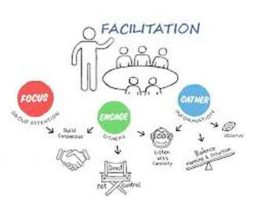
Facilitating a service design process
Create flat hierarchy.
Schedule.
Form a facilitating team.
Document each phase.
Create innovation.
Avoid dis-engagement.
Take pictures.
Check after every session and discuss.

Slide 23
Tips for using service design in Kazakhstan by Abilhasova Aiman, Head Nurse of the Occupational Therapy Department
1. the support of management, in the future this will facilitate the implementation of improved services;
2. when choosing a topic, focus on the problem that YOU, the Nurse, can solve;
3. when conducting the observation, be an "observer", do not interfere with patients, let them be "themselves".
4. when conducting an interview, try to ask revealing questions if necessary and be on the same wavelength with patients. The patient feels your sincerity and will open up, which will help you understand the problem in more depth.

Slide 24
References
Arnstein S. 1969. A Ladder of Citizen participation. AIP Journal https://www.historyofsocialwork.org/1969_ENG_Ladderofparticipation/1969,%20Arnstein,%20ladder%20of%20participation,%20original%20text%20OCR%20C.pdf
Dolan T. 2021. Double Diamond Design Process. https://www.kickframetoolbox.com/framework/double-diamond-design-process
Design perspectives: Design skills. 2020. Design Council. https://www.designcouncil.org.uk/fileadmin/uploads/dc/Documents/Design%2520Perspectives-%2520Design%2520Skills.pdf
Byond Net Zero: A Systemic Desgn Approach. 2021. Design Council. https://www.designcouncil.org.uk/fileadmin/uploads/dc/Documents/Beyond%2520Net%2520Zero%2520-%2520A%2520Systemic%2520Design%2520Approach.pdf
Fry KR. 2019. Why Hospitals Need Service Design: Challenges and methods for successful implementation of change in hospitals. DOI: 10.1007/978-3-030-00749-2_22 In book: Service Design and Service Thinking in Healthcare and Hospital Management. Theory, Concepts, Practice. Eds Pfannstiel MA Rasche C. Springer. Pp 377-399.
Moore K. 2020. Service Design Toolkit. https://digitalservices.maidstone.gov.uk/about-us/toolkits/service-design-toolkit
Moore K. 2021. Service Design Toolkit Framework https://digitalservices.maidstone.gov.uk/about-us/toolkits/service-design-toolkit/1-discover
Razzouk R & Shute V. 2012. What Is Design Thinking and Why Is It Important? Review of Educational Research, 82(3), 330–348. DOI: 10.3102/0034654312457429
Roberts JP, Fisher TR, Trowbridge MJ & Bent C. 2016. A design thinking framework for healthcare management and innovation. Healthcare 4(1), 11-14. https://doi.org/10.1016/j.hjdsi.2015.12.00
Simonse L, Albayrak A & Starre S. 2019 Patient journey method for integrated service design, Design for Health, 3:1, 82-97, DOI:10.1080/24735132.2019.1582741
The Scottish Approach to Service Design (SAtSD) - gov.scot (www.gov.scot
Yates P. 2018. Design Thinking: Can it enhance nursing research? Cancer Nursing, 41(4), 344-345. DOI: 10.1097/NCC.0000000000000630

