Slide 1
“Service design approach in the development of nursing services” Lecture 02 DISCOVERY Phase
Lisbeth Fagerström, Professor in Caring Science
Associate Professor at University of Southeast-Norway
Rector at Åbo Akademi University, Vaasa campus

Slide 2
Double Diamond Design Process
(Dolan 2021)
1. Discovery
2.Define
3.Develop
4.Deliver
What will we do to fully understand the problem and not proceed with assumptions?
How will we synthesize our findings to define our problem?
How will we generate many viable ideas to solve the problem?
How will we build, launch, and test our chosen solution?
A comprehensive understanding of the problem to be solved
A clear definition of problem to be solved and key success factors
A comprehensive understanding of potential solutions to the problem
A clear description of the solution to delivered and iterated upon

Slide 3
DISCOVERY phase
The start of a project is a period of discovery, gathering inspiration and insights, identifying user needs and developing initial ideas.
(Tuulaniemi 2018, Ferreira et al. 2015)

Slide 4
Tools and methods
User Journey Mapping
User Diaries
Service Safari
User Shadowing
https://www.designcouncil.org.uk/sites/default/files/asset/document/Design%20methods%20for%20developing%20services.pdf

Slide 5
A. User Journey Mapping (1/6) What is a user Journey Mapping?
A User Journey Map is a visual representation of a user’s journey through a service, showing all the different interactions they have.
Looking closer to parts of the service work from a user perspective
Can we identify ‘magic moments’ from a user perspective?
Are these ‘moments of truth’ good enough or what parts might need improving?
Notes:
*Magic moments are moments when customers feel special, delighted or otherwise impressed.
*Moments of truth are also known as a major touchpoint, these are the customer interactions that if not managed correctly can result in customers or prospects leaving you [https://www.signavio.com/post/upgrade-customer-experience-with-cjm/]

Slide 6
A. User Journey Mapping (2/6) The aim of the user journey mapping
• Identify the key elements of a service
• Understand the links between all the different elements over time
• Identify problem areas in a service or areas where new things can be added
• Create empathy with different types of users
https://www.designcouncil.org.uk/sites/default/files/asset/document/Design%20methods%20for%20developing%20services.pdf

Slide 7
A. User Journey Mapping (3/6) Methods for gathering real user experiences
Observation
Map a user’s progress through the service, beginning with when they first become aware of the service through to when they leave.
What are different activities of the user journey?
To understand the patient’s pathway through the entire care and treatment phases.

Slide 8
A. User Journey Mapping (4/6) Methods for gathering real user experiences
Identify the individual touchpoints with each stage
What are the links or gaps between touch points?
Will appear as maps are developed?
In order to get a holistic view of a user’s experience it can be useful to work in multidisciplinary teams.
Some services might have different types of users, with different experiences, and require multiple journeys

Slide 9
A. User Journey Mapping (5/6) The output of the User Journey Map
A User Journey Map is a visual map or diagram.
Identify clearly the key stages, touchpoints and other components that make up a user’s service experience.
The journey map might contain photographs, illustrations and quotes to bring it to life.
It may also have an additional layer of explanation that identifies problem areas or opportunities.
https://www.designcouncil.org.uk/sites/default/files/asset/document/Design%20methods%20for%20developing%20services.pdf

Slide 10
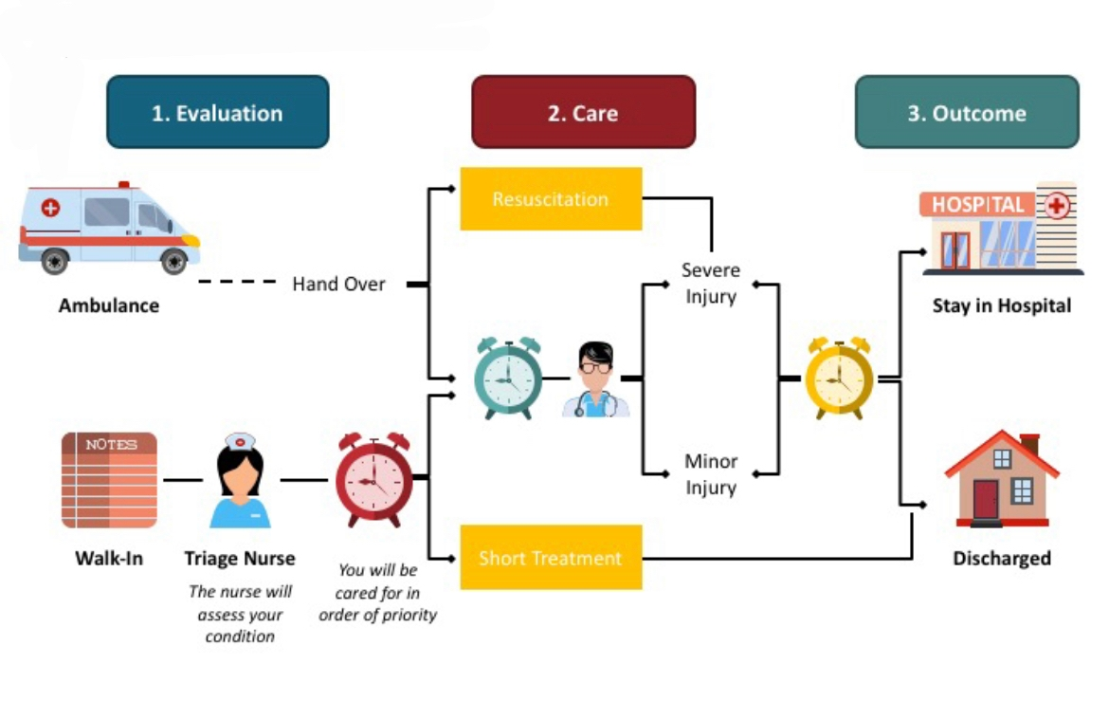

Slide 11
B. User Diary (1/6) What is a User Diary?
User Diaries are a method for gathering in-depth qualitative information (behaviors, activities, and experiences) from users by themselves.
In User Diaries, you can tell about your own life in your own time.
You will have the opportunity to explain what you are doing over a number of days or weeks.

Slide 12
B. User Diary (2/6) What is a User Diary?
User Diaries can be conducted in many different formats but usually consist of some personal background information and a ‘diary’ style format for capturing information over time.
This basic information can be supplemented with additional questions or tasks. Cameras or other documentation equipment may be provided to gather visual feedback for researchers.

Slide 13
B. User Diary (3/6) The aim of a User diary
• Gather information about real user needs
• Get understanding and empathy about other people’s experiences
• Get a sense of a user’s life over a longer period of time.
https://www.designcouncil.org.uk/sites/default/files/asset/document/Design%20methods%20for%20developing%20services.pdf

Slide 14
B. User Diary (4/6) How to do User Diaries?
User Diaries are created based on the context of the project and needs of the design team.
Same principles as for qualitative research
Crucial to identify the correct people who will take part.
A relatively small group is sufficient; the aim is to get rich information and insights to drive the design process, rather than quantitative answers.
The diary period can vary from a few hours to several months and again is dependent on the individual project.
https://www.designcouncil.org.uk/sites/default/files/asset/document/Design%20methods%20for%20developing%20services.pdf

Slide 15
B. User Diary (5/6) The main sections in User Diaries
Background information that covers name, age, occupation, location, family, hobbies & interests, likes & dislikes.
What kind of background information is needed for a better understanding of the person?
How long should the period be for the documentation in User Diaries?
https://www.designcouncil.org.uk/sites/default/files/asset/document/Design%20methods%20for%20developing%20services.pdf

Slide 16
B. User Diary (6/6) The main sections in User Diaries
• A number of prompts or questions can be introduced before starting, to provide some kind of a structure.
Is photography's or videos a recommendation?
• Additional questions and tasks with the aim of gaining more insight from the users on particular topics.
https://www.designcouncil.org.uk/sites/default/files/asset/document/Design%20methods%20for%20developing%20services.pdf

Slide 17
C. Service Safari Service Safari
The aim is to gather information about a service in the real world and to identify good service experiences within many different types of service.
A Service Safari is a research method for understanding services.
Researchers go into the real world and experience a service firsthand to find out what service experiences are like.
A Service Safari might be focused on a particular service (acute clinic for a patient group), or type of services (Emergency clinic).
Alternatively, the focus on a wider range of services to get an idea about what makes a positive service experience (looking at smaller and bigger centers for acute health problems).
https://www.designcouncil.org.uk/sites/default/files/asset/document/Design%20methods%20for%20developing%20services.pdf

Slide 18
D. Shadowing (1/3) The aim of User Shadowing
Gather information about real user needs
Get understanding and empathy of other people’s experiences
Understand the different parts of a service such as staging, interactions and touchpoints
Identifying barriers and opportunities for service innovation.
https://www.designcouncil.org.uk/sites/default/files/asset/document/Design%20methods%20for%20developing%20services.pdf

Slide 19
D. Shadowing ( 2/3) User shadowing in practice
Who could be the correct person to shadow?
- A small group of persons is enough.
Where will we find rich information and insights to promote the design process?
- The crucial thing is to spend time with the persons over a number of hours or days and observe what they are doing and why.
https://www.designcouncil.org.uk/sites/default/files/asset/document/Design%20methods%20for%20developing%20services.pdf
Notes:
NOTE: Shadowing is NOT done secretly!! Informed consent templates provided!

Slide 20
D. Shadowing ( 3/3) User shadowing in practice
A method for trying to understand a person’s life and with the aim to identify the barriers and opportunities he/she encounters.
This method may give a real understanding of service interactions and see the differences between what people say and what they do.
https://www.designcouncil.org.uk/sites/default/files/asset/document/Design%20methods%20for%20developing%20services.pdf

Slide 21
Different types of Interviews
Thematic interviews
Structured interviews
Semi-structured interviews
Open interviews
In-depth interviews
Focus group interviews
(Polit & Beck 2017)

Slide 22
Different types of Observation
Participating observation
Non-participating observation
Controlled observation
Un-controlled observation
Structured observation
Non-structured observation
(Polit & Beck 2017)

Slide 23
References
Caulliraux AA & Meirino MJ. 2015. The design thinking and the health services: The competitive differential through the humanization of patient experience. Brazilian Journal of Operation & Production Management, 12, 322-328.
Ferreira et al. 2015. New mindset in scientific method in the health field: Design thinking. Clinics, 70(12):770-772. DOI: 6061/clinics/2015(12)01
https://www.designcouncil.org.uk/sites/default/files/asset/document/Design%20methods%20for%20developing%20services.pdf
Polit D.F. & Beck C.T. 2017. Nursing Research: Generating and Assessing Evidence for Nursing Practice. 10th Edition, Wolters Kluwer Health, Philadelphia.
Tuulaniemi J. 2018. Palvelumuotoilu. E-book. 9789521416880. Adlibris.

Slide 24
Tools for the Discovery phase
1A. Define: the development challenge
1B The customer’s service pathway
1C Select your tools and design your development project (optional)
1D See your service trough the customer eyes
1E Framing
1F User Journey Plan Observation: documentation of user journey during shadowing and interviewing
1G Informed consent

Slide 25
1A. Define: the development challenge

Slide 26
1B The customer’s service pathway

Slide 27
1C Select your tools and design your development project (optional)

Slide 28
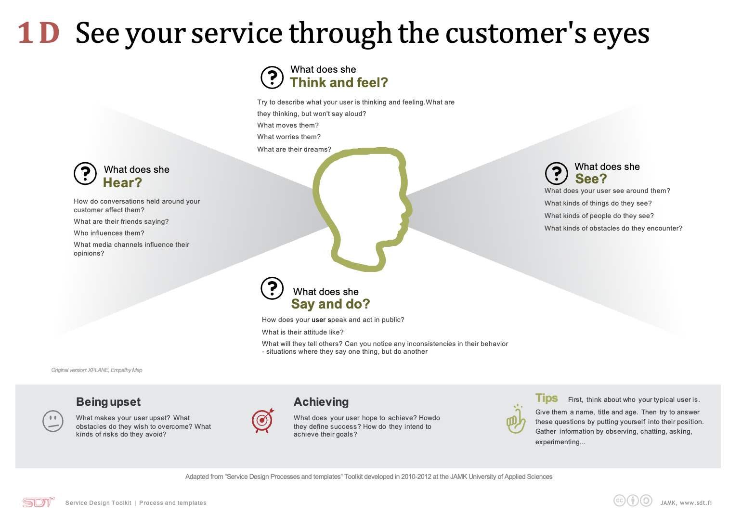
1D See your service trough the customer eyes

Slide 29
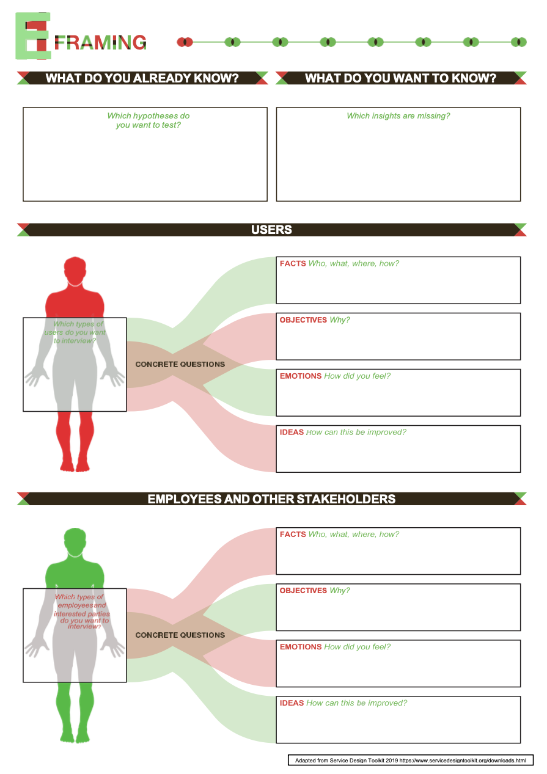
1E Framing.

Slide 30
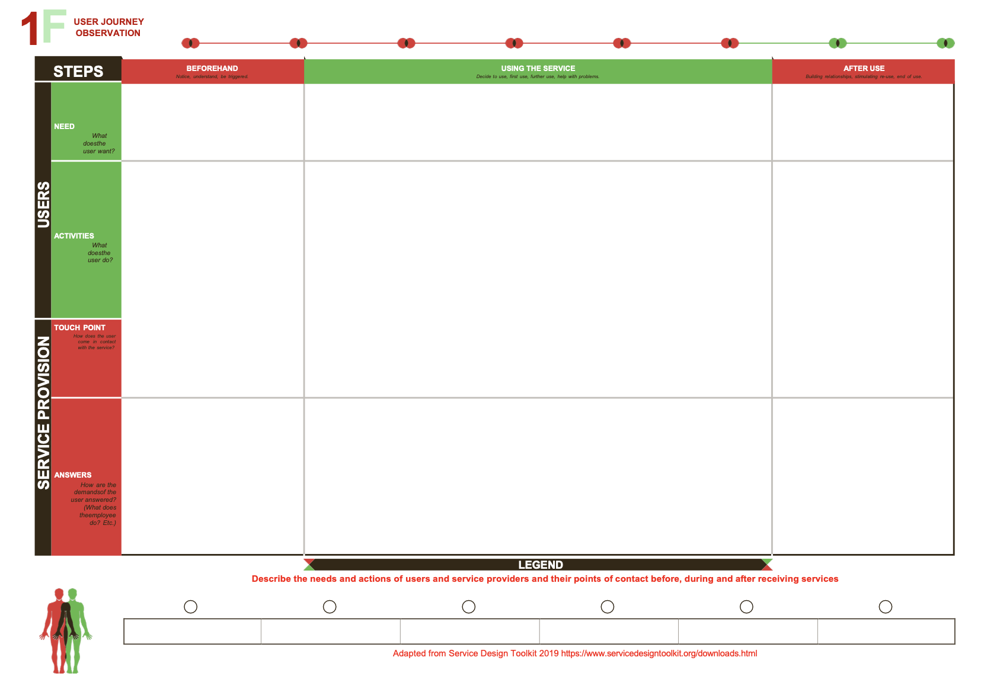
1F User Journey Plan Observation: documentation of user journey during shadowing and interviewing

Slide 31
1G Informed consent

