Slide 1
“Service design approach in the development of nursing services” Lecture 03 Defining phase
Prof. Aurelija Blazeviciene, LSMU

Slide 2
Double Diamond Design Process
1. Discover
2.Define
3.Develop
4.Deliver
(Dolan 2021)
What will we do to fully understand the problem and not proceed with assumptions?
How will we synthesize our findings to define our problem?
How will we generate many viabel ideas to solve the problem?
How will we build, launch, and test our chosen solution?
A comprehensive understanding of the problem to be solved
A clear definition of problem to be solved and key success factors
A comprehensive understanding of potential solutions to the problem
A clear descrption of the solution to delivered and iterated upon

Slide 3
Design Thinking: A Non-Linear Process
understand and share the feelings of another
https://www.interaction-design.org/
Notes:
“Empathise -
“Define -
“Ideate -
“Prototype -

Slide 4
The most challenging part of the Design Thinking process, as the definition of a problem will require you to synthesize your observations about your users from the first stage in the Design Thinking process, which is called the Empathise stage.
(https://experience.sap.com/skillup/introduction-to-design-thinking/)

Slide 5
In the Define stage you synthesise your observations about your users from the first stage, the Empathise stage.
A great definition of your problem statement will guide you and your team’s work and kick start the ideation process (third stage) in the right direction.
(https://experience.sap.com/skillup/introduction-to-design-thinking/)​

Slide 7
Analysis is about breaking down complex concepts and problems into smaller, easier-to-understand constituents. We do that, for instance, during the first stage of the Design Thinking process, the Empathise stage, when we observe and document details that relate to our users.
Synthesis, on the other hand, involves creatively piecing the puzzle together to form whole ideas. This happens during the Define stage when we organise, interpret, and make sense of the data we have gathered to create a problem statement
Analysis
Define
Synthesis
https://gbksoft.com/blog/design-thinking/
Notes:
.//

Slide 8
How to Define a Problem Statement

Slide 9
DEFINE
What?
to develop a deep understanding of your users and the design space and, based on that understanding, to come up with an actionable problem statement: your point of view.
Why?
This reframed problem statement can then be used as a solution-generating springboard.

Slide 10
A good problem statement should thus have the following traits
Human-centered. This requires you to frame your problem statement according to specific users, their needs and the insights that your team has gained in the Empathise phase. The problem statement should be about the people the team is trying to help, rather than focusing on technology, monetary returns or product specifications.
Broad enough for creative freedom. This means that the problem statement should not focus too narrowly on a specific method regarding the implementation of the solution. The problem statement should also not list technical requirements, as this would unnecessarily restrict the team and prevent them from exploring areas that might bring unexpected value and insight to the project.
Narrow enough to make it manageable. On the other hand, a problem statement such as , “Improve the human condition,” is too broad and will likely cause team members to easily feel daunted.
(Akama 2015; Vennik et al 2015).

Slide 11
A good point of view is one that:
Provides focus and frames the problem
Inspires your team
Provides a reference for evaluating competing ideas
Empowers team members to make decisions in response to the high-level goals of the team
Fuels brainstorms by suggesting “how might we” statements
Captures the hearts and minds of people you meet
Saves you from the impossible task of developing solution concepts that are all things to all people
You revisit and reformulate as you learn by doing
Guides your innovation efforts
Akama, Y. (2015). Service Design: From Insight to Implementation. Design and Culture.
Vennik, F. D., van de Bovenkamp, H. M., Putters, K., & Grit, K. J. (2015).Co-production in healthcare: rhetoric and practice. International Review of Administrative Sciences, 0020852315570553

Slide 13
When you’ve defined your design challenge in a POV, you can start to generate ideas to solve your design challenge. You can start using your POV by asking a specific question starting with: “How Might We” or “in what ways might we”.
They should be broad enough for a wide range of solutions, but narrow enough that specific solutions can be created for them. How Might We (HMW) questions are questions that have the potential to spark ideation sessions such as brainstorms.. “How Might We” questions should be based on the observations you’ve gathered in the Empathise stage of the Design Thinking process
Как бы мы могли…

Slide 14
For example, you have observed that youths tend not to watch TV programs on the TV at home, some questions which can guide and spark your ideation session could be:
How might we make TV more social, so youths feel more engaged?
How might we enable TV programs to be watched anywhere, at anytime?
How might we make watching TV at home more exciting?
The HMW questions open up to Ideation sessions where you explore ideas, which can help you solve your design challenge in an innovative way.
Design Thinking — The Beginner’s Guide: https://www.interaction-design.org/courses/design-thinking-the-beginner-s-guide

Slide 15
References
Akama, Y. 2015. Service Design: From Insight to Implementation. Design and Culture. Book review. Design and Culture (7), 259-261. https://doi.org/10.1080/17547075.2015.1051837
Vennik, F. D., van de Bovenkamp, H. M., Putters, K., & Grit, K. J. 2016. Co-production in healthcare: rhetoric and practice. International Review of Administrative Sciences, 82(1) 150–168. DOI: 10.1177/0020852315570553.
Design Thinking — The Beginner’s Guide: https://www.interaction-design.org/courses/design-thinking-the-beginner-s-guide
https://www.interaction-design.org/
https://gbksoft.com/blog/design-thinking/

Slide 16
Tools for the Discovery phase
2A Empathy map
2B The customer point of view
2C Mind map
2D Forming solutions

Slide 17
2A Empathy map

Slide 18
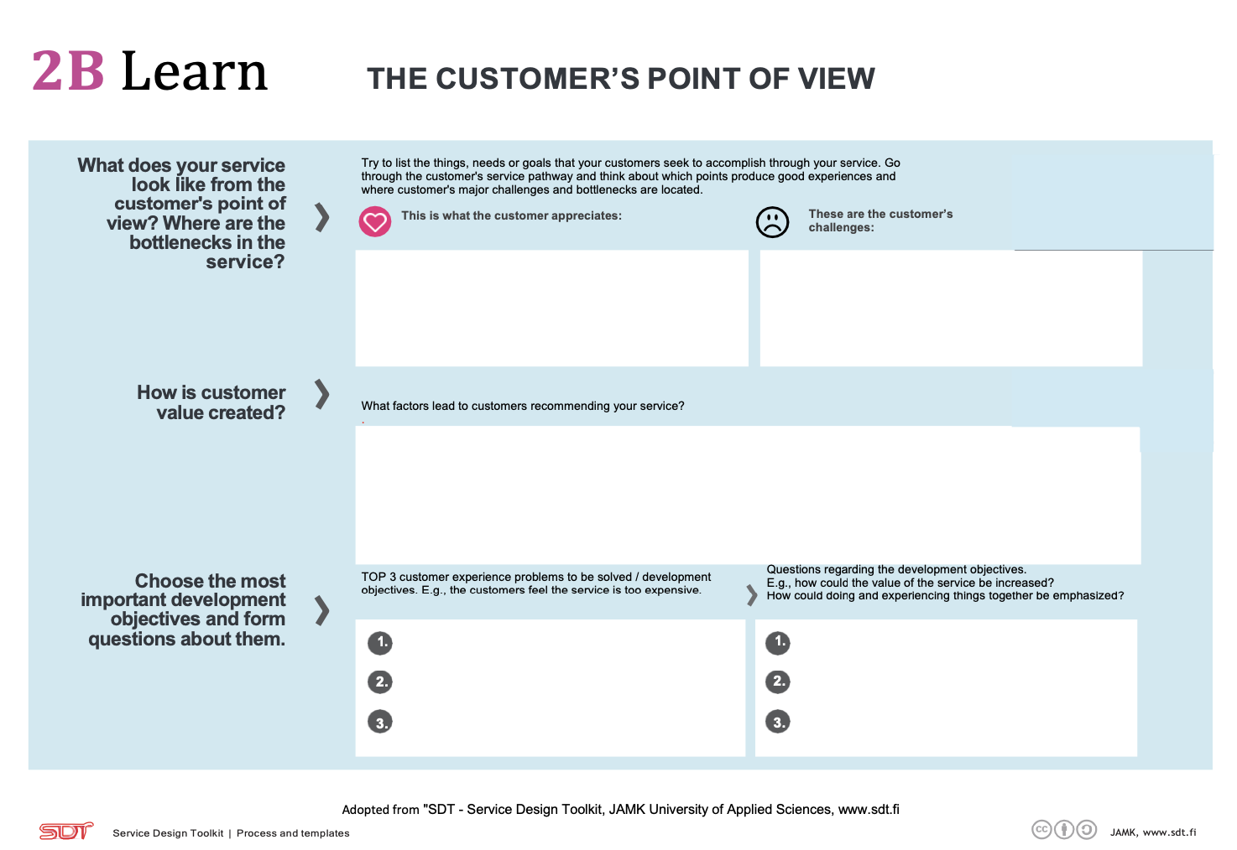
2B The customer point of view

Slide 19
2C Mind map
To do this, you can use a blank flipchart and markers for a more colorful and understandable description.

Slide 20
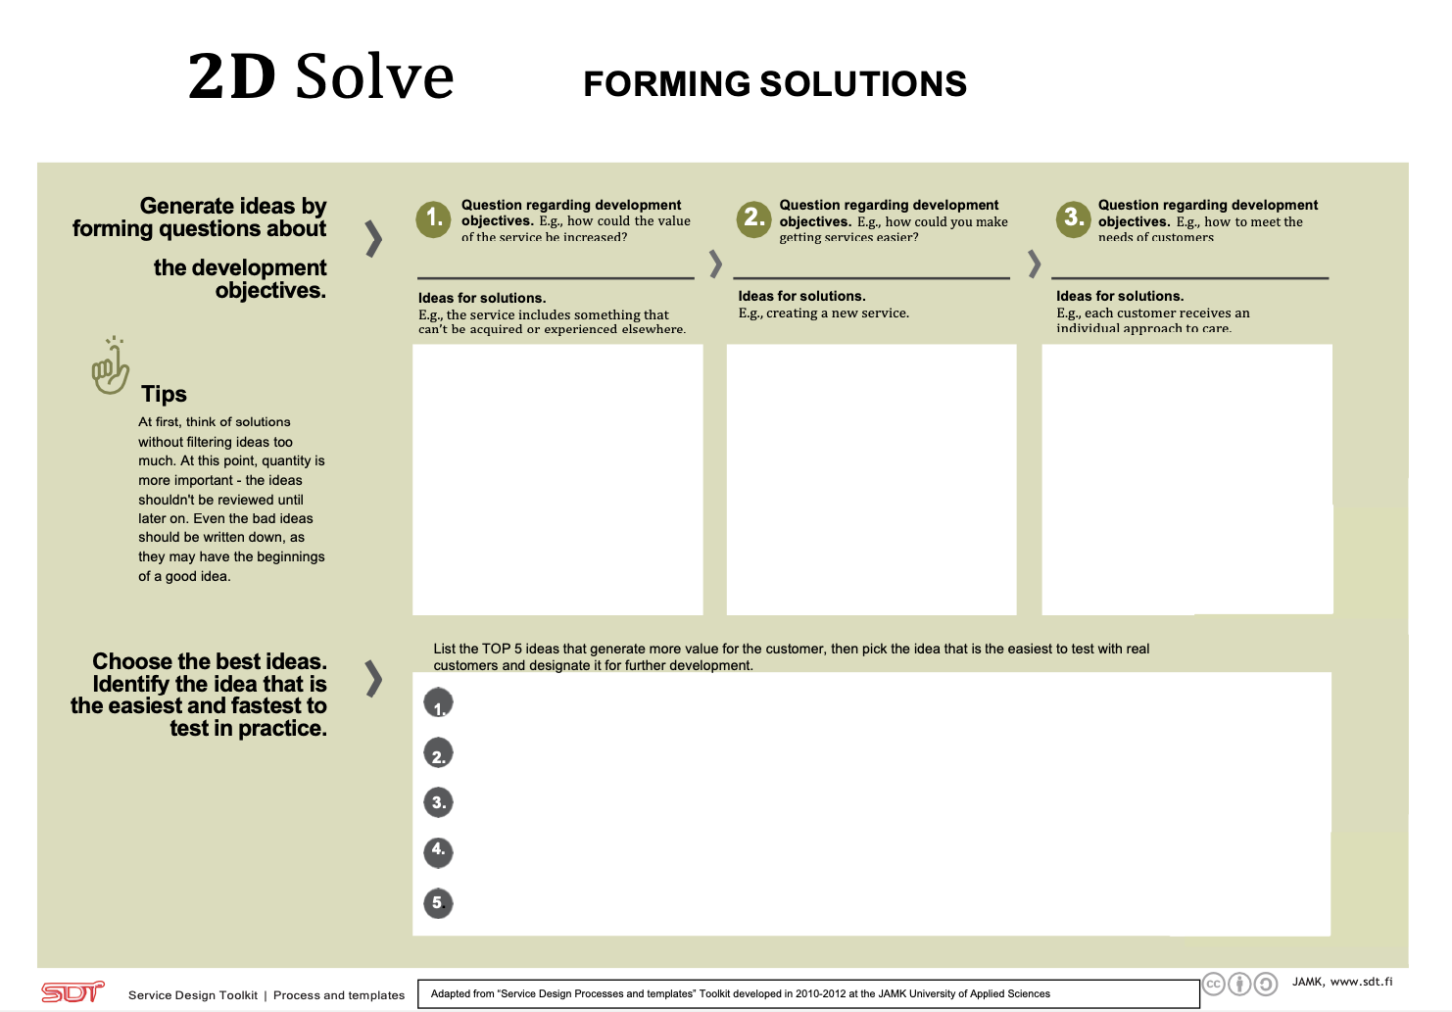
2D Forming solutions

