Slide 1
“Service design approach in the development of nursing services” Lecture 05 Developing 3 phase
Presented by Paolo colet
Nazarbayev university, school of Medicine

Slide 2
Double Diamond Design Process
1. Discover
2.Define
3.Develop
4.Deliver
(Dolan 2021)
What will we do to fully understand the problem and not proceed with assumptions?
How will we synthesize our findings to define our problem?
How will we generate many viabel ideas to solve the problem?
How will we build, launch, and test our chosen solution?
A comprehensive understanding of the problem to be solved
A clear definition of problem to be solved and key success factors
A comprehensive understanding of potential solutions to the problem
A clear descrption of the solution to delivered and iterated upon

Slide 3
Develop
First step in creating solution
Develop or developing is third on the service design process
Stage of developing solutions
Done through a DIVERGENT APPROACH
Divergent approach
Suggest that all identified solutions are considered prototypes (product/model/process for testing)
Photo credit to https://www.reshot.com/
Notes:
Divergent approach
Suggest that all identified solutions are considered prototypes (product/model/process for testing)

Slide 4
Develop
What do the team/nurses do here?
Illustrate/determine the target users by creating a PERSONAS or USER PERSONAS
Personas are a character that represent the target use
Importance
user’s characteristics is considered (take into account) in developing solutions
“create understanding and empathy with the end user(s).” https://www.keepitusable.com/blog/personas-why-is-it-important-to-understand-your-users/
Build prototype of solution
Test with end-user (iterative process of trial and error)
Notes:
Iterative = doing something again and again, usually to improve it [7] It is going back and forth during the steps or processes of the design to improve the actions/solutions
Reference https://dictionary.cambridge.org/dictionary/english/iterative
Users/ Clients; Customers; End-users = In a design context, the term “user” would commonly refer to people using a product or a service [1]
Reference A.K. FORSHAUG & J.B. SIGURJÓNSSON. User involvement in design of health care services, INTERNATIONAL CONFERENCE ON ENGINEERING AND PRODUCT DESIGN EDUCATION.
Prototype = the first design of something from which other forms are copied or developed [11] ; In design it is the early version of solution to be tested and improve
Reference https://www.oxfordlearnersdictionaries.com/definition/english/prototype?q=prototype

Slide 5
Develop
What do the team/nurses do here?
Methods and Tools use
Personas
Service Blueprint
Experience prototyping
And many other more…
Notes:
Experience prototyping: Testing the solution with end-user and their feedback will be used to improve the solution

Slide 6
Tools & Methods : 3 A. Personas
This Photo by Unknown Author is licensed under CC BY-NC-ND

Slide 7
Tools & Methods : 3 A. Personas (1/9)
What it is?
Identification of different types of end-users (patients) and their different needs
Created through several formats using text and images
The text can be of the user’s profile. For example:
Demographics
General traits
Psychological traits
Notes:
Demographics- age, gender etc.
General- occupation, interests, hobbies etc.
Psychological- needs and goals

Slide 8
Tools & Methods : 3 A. Personas (2/9)
How to do it?
Process of developing personas
Data collection
Hypothesis or drafting of personas
Scenarios
Personas’ description
Selection of personas
Dissemination
(Keeptitusable. (n.d.) )
Notes:
Reference
Keeptitusable. (n.d.) Personas: Why is it important to understand your users? https://www.keepitusable.com/blog/personas-why-is-it-important-to-understand-your-users/

Slide 9
Tools & Methods : 3 A. Personas (3/9)
How to do it?
Process of developing personas (1/5)
Data collection
Observation
Interview
Focus group
Survey
Social media
Analytics
Data collection is done during Discovery phase. Refer to the data you collected to create personas

Slide 10
Tools & Methods : 3 A. Personas (4/9)
How to do it?
Process of developing personas (2/5)
Hypothesis or drafting of personas
Draft of several users
Use 3A which is the different model of client behavior template, to draft the personas’ behavior/characteristics

Slide 11
Tools & Methods : 3 A. Personas (5/9)
How to do it?
Process of developing personas (3/5)
Scenarios
This is about how the persona use the service or product (imagined situation)
Description of how the persona use the service/solutions
End-user interaction with the service/product
Use 3A which is the different model of client behavior template to draft the personas’ behavior/characteristics
Notes:
Use 3A which is the different model of client behavior template to draft the personas’ behavior/characteristics
Scenarios: Story how the character/ patient will use the service

Slide 12
Tools & Methods : 3 A. Personas (6/9)
How to do it?
Process of developing personas (4/5)
Personas’ description
Description of the end-user (detailing including the scenario)
Generate a narration of the character

Slide 13
Tools & Methods : 3 A. Personas (7/9)
How to do it?
Process of developing personas (5/5)
Selection of personas
Selection of personas that represent the end-users
Choose 3-6 personas
Dissemination
Share results/findings with the team

Slide 14
Tools & Methods : 3 A. Personas (8/9)
Benefits
Understanding of end-users
Foster empathy
Behavior
Needs
Goals

Slide 15
Tools & Methods : 3 A. Personas (9/9)
Output?
Sketch of different personas with end-users’ information
Communicated through visual materials
And these PERSONAS are useful to guide in creating a solution (they help focuses the design of solutions)
It should be noted that personas are archetypes (representative profile) and not stereotypes
Notes:
Use photos of individuals that closely depicts the persona (NO celebrity)

Slide 16
Photo credit to https://www.keepitusable.com/blog/personas-why-is-it-important-to-understand-your-users/

Slide 17
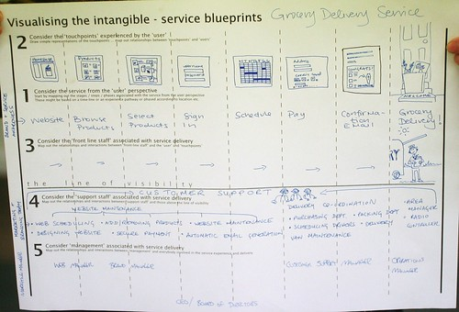
Tools & Methods B Service blueprint
This Photo by Unknown Author is licensed under CC BY-SA-NC

Slide 18
Tools & Methods B Service blueprint (1/9)
What it is?
Considered to be the second part/follow-up to user’s journey
Service blueprint combines the user’s experience and the workers’ actions/support

Slide 19
Tools & Methods B. Service blueprint (2/ 9)
What it is?
Visual representation of the service (process how service is delivered/ task of providing the service/ steps in the process of providing service)
Mapping the future service (which include the provider/end-users)
Visualize using the user pathway/patient journey

Slide 20
Tools & Methods B. Service blueprint (3/9)
What it is?
A visual diagram of a service that shows the role of the end-users and employees
Use in planning and as a guide in implementing new service

Slide 21
Tools & Methods B Service blueprint (4/9)
Components
Service space visible to the customer
Customer activity
Visible activities of customer service personnel (stage)
Invisible activity of customer service staff (back room)
Support processes
(Adopted from Innokyla, n.d.)
Notes:
Reference https://innokyla.fi/fi/tyokalut/service-blueprint

Slide 22
Tools & Methods B Service blueprint (5/9)
Components
”Service space visible to the customer
Customer activity”
Description of the customer’s experience (all the steps being done)
(Adopted from Innokyla, n.d.)
Notes:
Reference https://innokyla.fi/fi/tyokalut/service-blueprint

Slide 23
Tools & Methods B Service blueprint (6/9)
”Visible activities of customer service personnel”
Customer’s direct interaction with the employee providing the service
Activities that are visible to the customer
(Adopted from Innokyla, n.d.)
Notes:
Reference https://innokyla.fi/fi/tyokalut/service-blueprint

Slide 24
Tools & Methods B Service blueprint (7/9)
Components
Invisible / invisible activity of customer service staff (back room) and
Support processes
Activities that are invisble to the customer

Slide 25
Tools & Methods B Service blueprint (8/9)
How to do it?
Steps
Identification of service processes
Identification of customers (who)
Description of service
Activities of employee (visible/invisible)
Identification of support functions
(Adopted from Innokyla, n.d.)
Notes:
Reference https://innokyla.fi/fi/tyokalut/service-blueprint

Slide 26
Tools & Methods B. Service blueprint (9/9)
Output?
Visual map/diagram of a service
Help employees to visualize and understand the role and what users will be experiencing

Slide 27
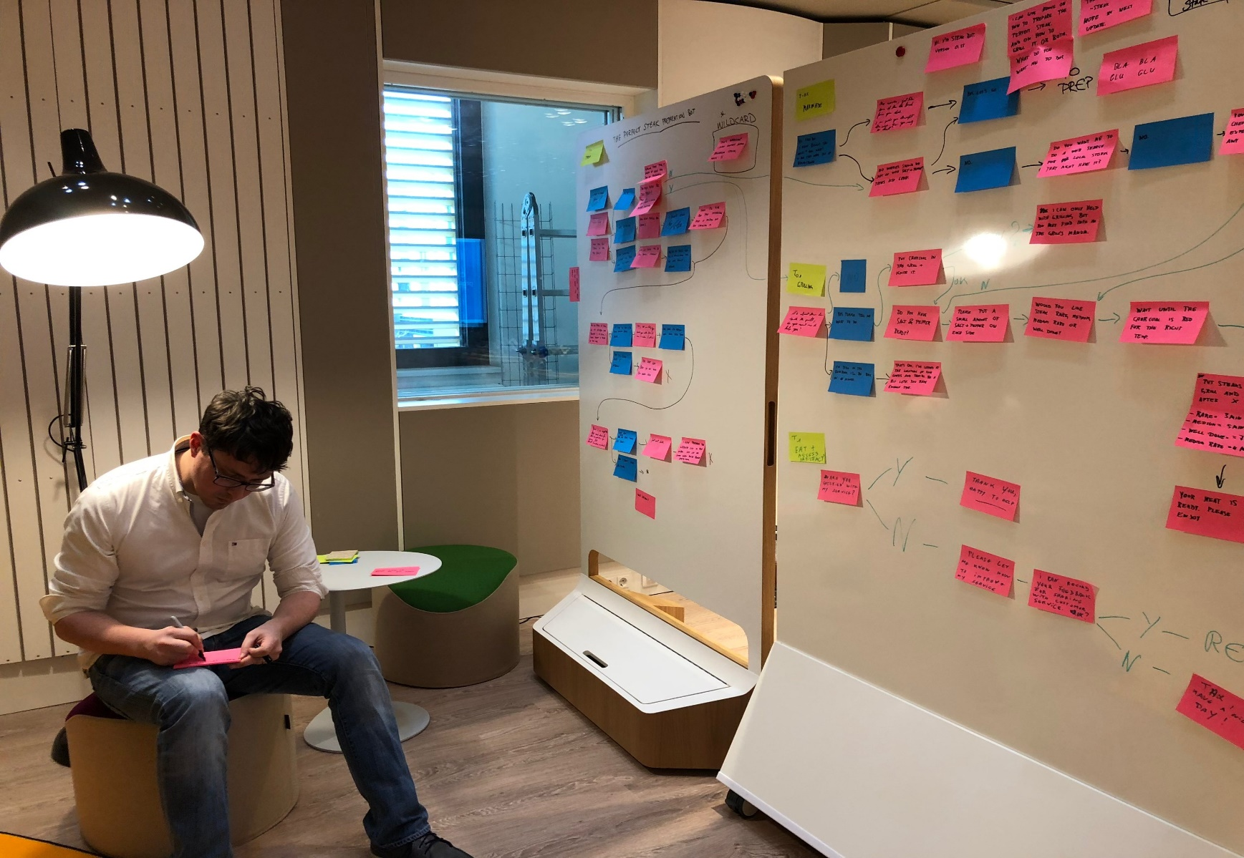
This Photo by Unknown Author is licensed under CC BY-SA

Slide 28
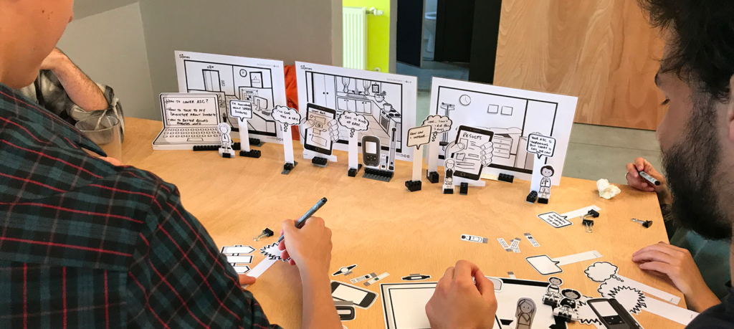
Tools & Methods: C. Experience prototyping
This Photo by Unknown Author is licensed under CC BY-SA-NC
Notes:
Prototype = Early version of concept of solution or process

Slide 29
Tools & Methods: C. Experience prototyping (1/5)
What it is?
Testing of newly designed service ideas
It communicates what will be the experience of costumers
It allows designers to refine solutions
Promotes ownership/buy in from the members of the organization

Slide 30
Tools & Methods: C. Experience prototyping (2/5)
What it is?
Prototypes do not need to be perfect since it will be tested
Ultimate goal is to gather input or feedback from customers for improving the service

Slide 31
Tools & Methods: C. Experience prototyping (3/5)
How to do it?
Role playing
Mock-up products
Mock-up environment

Slide 32
Tools & Methods: C. Experience prototyping (4/5)
How to do it?
One may use photoshoots or video during practice implementation of the service

Slide 33
Tools & Methods: C. Experience prototyping (5/5)
Output?
Several numbers of mock-ups
Documentation
Share feedback from customer during the mock-up

Slide 34
Thank you

Slide 35
References
Design Council. (2015). Design methods for developing services. https://www.designcouncil.org.uk/resources/guide/design-methods-developing-services
Innokyla. (n.d.). Service blueprint. https://innokyla.fi/fi/tyokalut/service-blueprint
Keepitusable. (n.d.). Personas: Why is it important to understand your users? https://www.keepitusable.com/blog/personas-why-is-it-important-to-understand-your-users/

Slide 36
Tools for the Discovery phase
3A USER profiles
3B Persona template
3C Blueprint / Improved Care pathway

Slide 37
3A USER profiles

Slide 38
3B Persona template

Slide 39
3C Blueprint / Improved Care pathway

