Slide 1
“Service design approach in the development of nursing services”
Lecture 06
DELIVERING Phase
&
Evaluating the improvement in service design projects by using the theory of realist evaluation
Maria Björkmark
University teacher, Phd-candidate
Department of caring science
Åbo Akademi university, Vaasa, finland

Slide 2
Double Diamond Design Process
1. Discover
2.Define
3.Develop
4.Deliver
(Dolan 2021)
What will we do to fully understand the problem and not proceed with assumptions?
How will we synthesize our findings to define our problem?
How will we generate many viabel ideas to solve the problem?
How will we build, launch, and test our chosen solution?
A comprehensive understanding of the problem to be solved
A clear definition of problem to be solved and key success factors
A comprehensive understanding of potential solutions to the problem
A clear descrption of the solution to delivered and iterated upon

Slide 3
Phase 4: Deliver
A review date should be agreed (normally 6-12months from ‘go live’).
Ensure you have all the measures to identify if the changes have been a success and what benefits you expect to receive.
Check the service is delivering what you expected.
Ensure systems are in place to capture user feedback, especially for services.
The Deliver phase is the point to feedback lessons from the process to colleagues and partners, sharing new knowledge, insight tools, or ways of working.
Objectives
  Taking product or service to launch
  Ensure customer feedback mechanisms are in place
  Share lessons from development process back into the organisation.
  (Moore 2021 Service Design Toolkit. https://digitalservices.maidstone.gov.uk/about-us/toolkits/service-design-toolkit/5-deliver)
Notes:
The delivery phase is simply when the service goes live. Therefore no work needs to be carried out initially in the delivery phase. However, a review date should be agreed (normally 6-12months from ‘go live’).

Slide 4
Evaluating the improvement in service design projects by using the theory of realist evaluation
Maria Björkmark
University teacher, Phd-candidate
Department of caring science
Åbo Akademi university, Vaasa, finland

Slide 5
Why Realist evaluation?
Implementing and evaluating new interventions may be challenging and especially evaluations need a creative approach
How do we evaluate the implementation of evidence-based care?
The same interventions will not work everywhere and for everyone.

Slide 6
Why Realist evaluation?
“What is really going on here, beyond what I can see??”
Holistic approach:
Not just physical components of health, but psychosocial, environmental and contextual aspects as well

Slide 7
Why Realist evaluation?
The term “Realist Evaluation” first introduced by Pawson & Tilley (1997)
Based on realism, a philosophical perspective in which the social world is viewed as real
The surrounding culture, social, economic and political structures as well as organizational, geographical and historical context can have a real effect on whether interventions/programs work

Slide 8
Why Realist evaluation?
Research methodology that provides a framework for conducting an evaluation of healthcare interventions
Traditional approaches of evaluations simply measure and report the results, without considering the environment, culture, human behaviors and emotional reactions regarding the intervention and its outcome
Focuses on explaining WHY an intervention works/does not work

Slide 9

Key questions
“What works, for whom, under what circumstances and how?”

Slide 10
When to use realist evaluation?
Evaluating complex interventions such as community based public health programs
Evaluating programs that produce mixed outcomes to better understand how and why differential outcomes occur.
In addition to the outcomes, evaluation of the processes of how the intervention has worked, peoples’ actions and reactions etc.

Slide 11

SUCCESS
Success often depends on contextual factors and therefore evaluation of these is crucial

Slide 12
KEY CONCEPTS
CMO:
Context
Mechanism
Outcome
”Outcomes are the result of Mechanisms triggered in a specific Context”

Slide 13
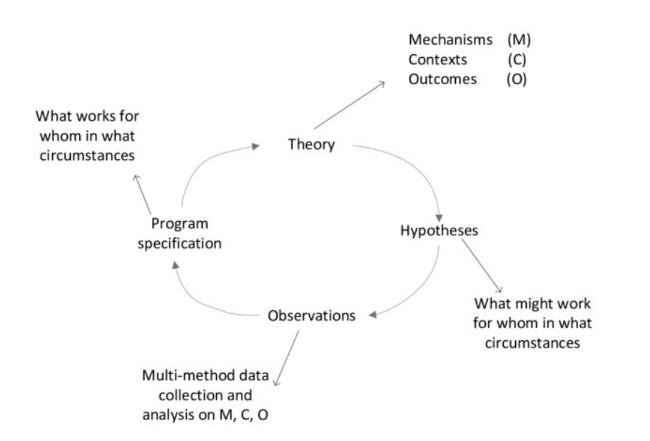

Slide 14
Hypotheses
1. For whom will this intervention work and not work, and why?
2. In what contexts will this intervention and not work, and why?
3. What are the main mechanisms by which we expect this intervention to work?
4. If this intervention works, what outcomes will we see?

Slide 15
Observations
The hypotheses are tested.
Mixed methods data collection on CMO.
Analysis of CMO.

Slide 16
Observations
For example:
Which specific aspects of context might impact on outcomes and which specific mechanisms might be creating change?
Does an intervention work more or less well, through different mechanisms, in different environments localities (how and why); or for different population groups (e.g. men and women, or groups with differing socioeconomic status).

Slide 17
Programme specification
Identify a Programme specification theory.
Describe the outcome generated by a specific mechanism in a specific context.

Slide 18
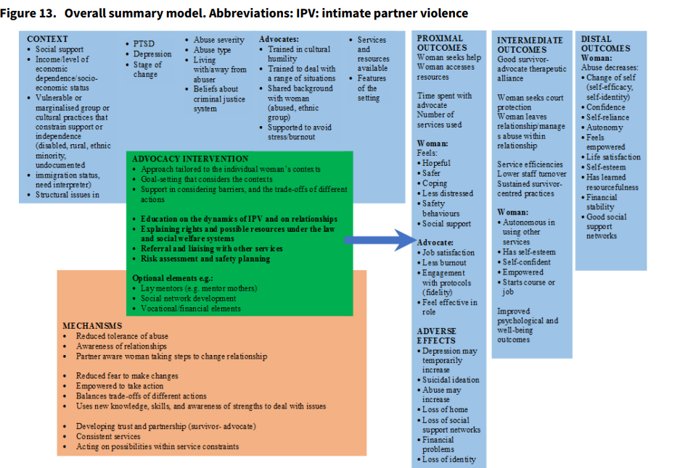

Slide 19
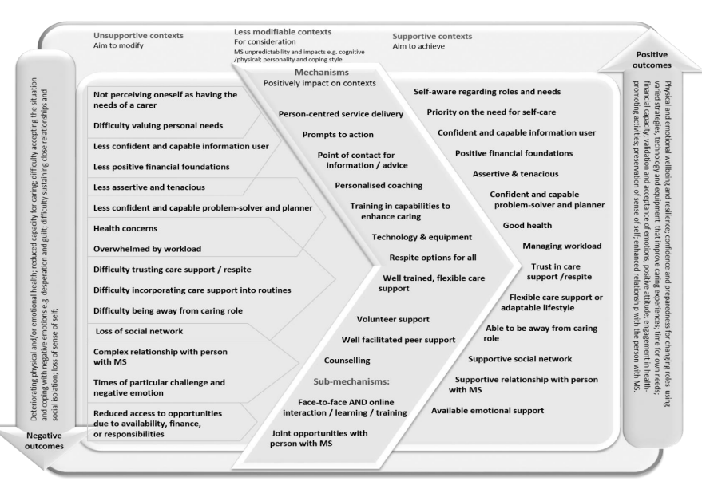

Slide 20
Examples of studies
Bulley, C., Baer, G., Mahal, D., Buckton, C., Donald, S., Lugton, K., Gillespie, D., McCormack, B. (2021). Supporting families and carers of people living with multiple sclerosis: A rapid realist review and realist evaluation. International Journal of Care and Caring, 5(2), 263-282.
Rycroft-Malone, J., Seers, K., Eldh, A., Cox, K., Crichton, N., Harvey, G., Hawkes, C., Kitson, A., McCormack, B., Mcmullan, C., et al (2018). A realist process evaluation within the Facilitating Implementation of Research Evidence (FIRE) cluster randomised controlled international trial: An exemplar. Implementation Science, 13(1).
Dickson, M., Riddell, H., Gilmour, F., McCormack, B. (2017). Delivering dignified care: A realist synthesis of evidence that promotes effective listening to and learning from older people's feedback in acute care settings. Journal of Clinical Nursing, 26(23-24), 4028-4038.
Rycroft-Malone, J., Burton, C., Wilkinson, J., Harvey, G., McCormack, B., Baker, R., Dopson, S., Graham, I., Staniszewska, S., Thompson, C., et al (2016). Collective action for implementation: A realist evaluation of organisational collaboration in healthcare. Implementation Science, 11(1).
Williams, L., Rycroft-Malone, J., Burton, C., Edwards, S., Fisher, D., Hall, B., McCormack, B., Nutley, S., Seddon, D., Williams, R. (2016). Improving skills and care standards in the support workforce for older people: a realist synthesis of workforce development interventions. BMJ Open, 6(8), e011964.

Slide 21
REFERENCES
Bulley, C., Baer, G., Mahal, D., Buckton, C. H., Donald, S., Lugton, K., . . . McCormack, B. (2021). Supporting families and carers of people living with multiple sclerosis: A rapid realist review and realist evaluation. International journal of care and caring, 5(2), 263-282. https://doi.org/10.1332/239788220X16020938693101 (figure slide 16)
Greenhalgh, T., Wong, G., Jagosh, J., Greenhalgh, J., Manzano, A., Westhorp, G. & Pawson, R. (2015). Protocol—the RAMESES II study: Developing guidance and reporting standards for realist evaluation. BMJ open, 5(8), e008567. https://doi.org/10.1136/bmjopen-2015-008567
Jack, K. (2022). What is realist evaluation? Evidence-based nursing. https://doi.org/10.1136/ebnurs-2022-103608
Pawson, R. & Tilley, N. (1997). Realistic evaluation. SAGE. (figure slide 10)
Public Health England: A brief introduction to realist evaluation
Rivas, C., Vigurs, C., Cameron, J. & Yeo, L. (2019). A realist review of which advocacy interventions work for which abused women under what circumstances. Cochrane database of systematic reviews, 6(6), CD013135. https://doi.org/10.1002/14651858.CD013135.pub2 (figure slide 15)

Slide 22
Tools for the Delivery phase
4A Collect information, improve and productize your service

Slide 23
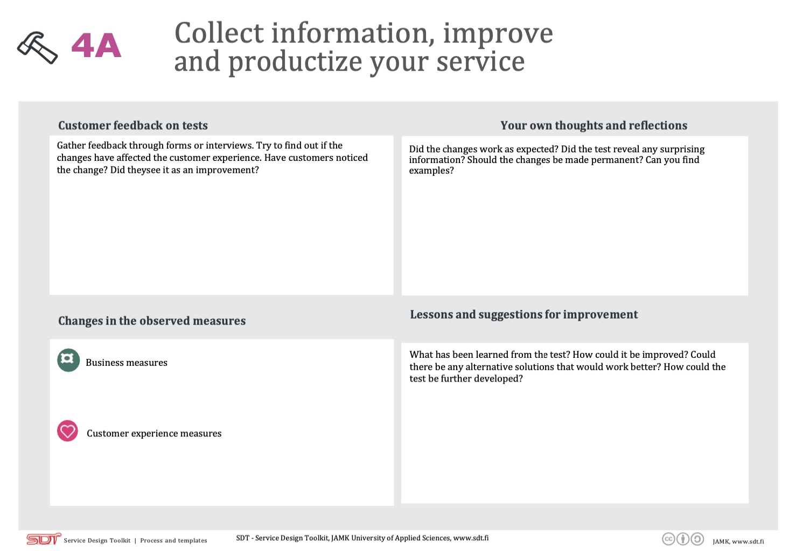
4A Collect information, improve and productize your service

