Slide 1
“Service design approach in the development of nursing services” Example for Developing
0B
Presented by Paolo colet
Nazarbayev university, school of Medicine

Slide 2
Example 1
Miaskiewicz, T., & Kozar, K. A. (2011). Personas and user-centered design: How can personas benefit product design processes? Design studies, 32(5), 417-430.
User – a person who uses the service (patient, nurse, etc.)
Person – the nature of the group of users of the service
Explore PERSONAS as a strategy for addressing and conveying client needs…
Many fail to utilized this tool in design process

Slide 3
Personas and user-centered design: How can personas benefit product design processes?
Introduction
User-centered design
Also known as, human-centered design, customer-centered design
Philosophy
Involve users in design process
Notes:
“Service design is the activity of planning ….of a service in order to improve its quality and the interaction between the service provider and its customers.” https://hospitalityinsights.ehl.edu/what-is-service-design
Similarities and difference between Service-design and User-centered design
http://www.satukyrolainen.com/service-design-vs-user-centered-design/

Slide 4
Personas and user-centered design: How can personas benefit product design processes?
Introduction
Personas:
‘fictitious, specific, concrete representations of target users’ (Pruitt & Adlin, 2006, p 11; as cited in Miaskiewicz & Kozar, 2011).
Represent the aggregates of customers

Slide 5
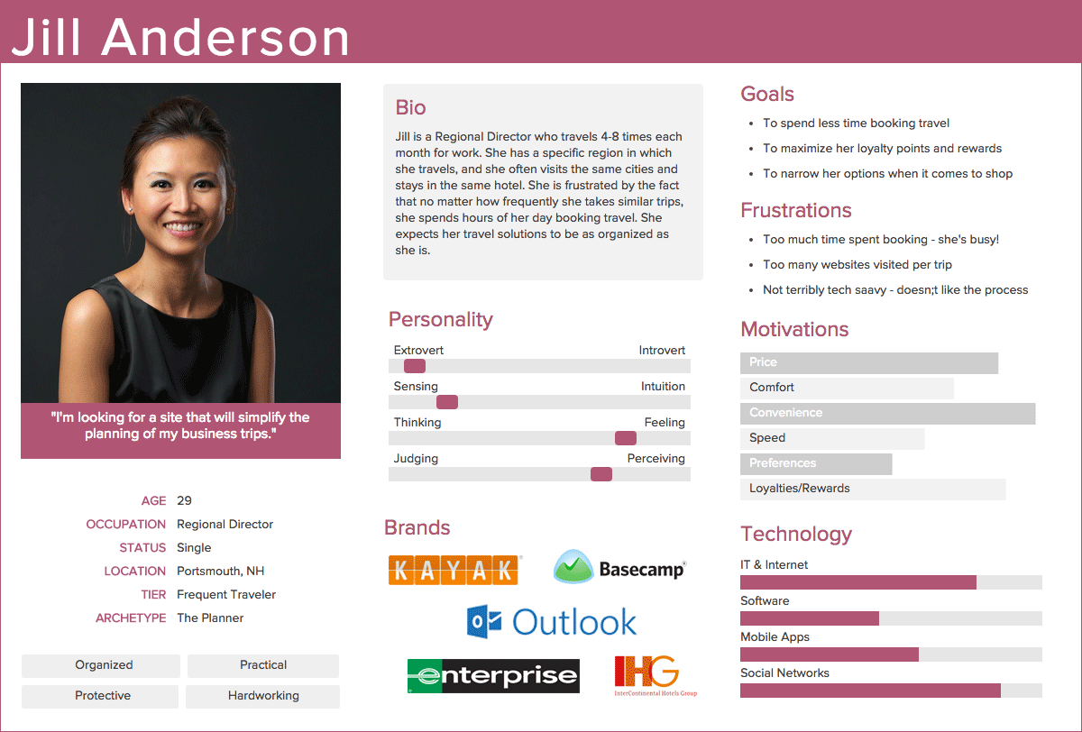
Personas and user-centered design: How can personas benefit product design processes?
Characteristics of Personas:
Not a real person
Have a name and picture
Described in a narrative
To make it realistic
Provide a story
It starts with likes, dislikes, occupation, etc.
Inform design decision
Photo credit to https://www.keepitusable.com/blog/personas-why-is-it-important-to-understand-your-users/
Credit to https://www.keepitusable.com/blog/personas-why-is-it-important-to-understand-your-users/

Slide 6
Personas and user-centered design: How can personas benefit product design processes?
Introduction
Anecdotal evidence
Facilitate useful and usable design
Aid in designing
Provide a snapshot of personas literature
Lack solid empirical grounding

Slide 7
Personas and user-centered design: How can personas benefit product design processes?
Methods
In this study…
“the Delphi method is used to examine personas and to provide a stronger foundation for future research on personas”(Miaskiewicz & Kozar, 2011)
Notes:
“The method is particularly useful when applied to research topics that lack a strong empirical foundation and that
could benefit from the opinion of experts (Okoli & Pawlowski, 2004). “Miaskiewicz & Kozar, 2011

Slide 8
Personas and user-centered design: How can personas benefit product design processes?
Methods
In this study…
“The Delphi method is a group process used to seek, aggregate, and gain consensus on the opinions of a group of panelists” (Schmidt, 1997; as cited in Miaskiewicz & Kozar, 2011)”.
Notes:
“The method is particularly useful when applied to research topics that lack a strong empirical foundation and that
could benefit from the opinion of experts (Okoli & Pawlowski, 2004). “Miaskiewicz & Kozar, 2011

Slide 9
Personas and user-centered design: How can personas benefit product design processes?
Results
Diverging views of how personas are beneficial
Moderate consensus among the experts on the benefits of personas

Slide 10
Personas and user-centered design: How can personas benefit product design processes?
Results and Implications (22 results)
Audience focus
Product requirements prioritization
Audience prioritization
Challenge assumptions
Prevention of self-referential design
Significant benefit
Ability to focus design and overcome disconnection between designers and consumers… to establish a consumer-centered design…to narrow target consumers
Notes:
1/2/3- Significant benefit = ABILITY TO FOCUS DESIGN and OVERCOME the DISCONNECT between DESIGNERS and CONSTUMERS
4/5- ABILITY TO ESTABLISH A CONSUMER-CENTERED DESIGN»

Slide 11
Personas and user-centered design: How can personas benefit product design processes?
Results and Implications
Decision guide
Agreement catalyst
Engagement and unification
Empathy creation
Innovative thinking
Team collaboration
Communication aid
Problem scope definition
Evaluation guide

Slide 12
Personas and user-centered design: How can personas benefit product design processes?
Results and Implications
Organization of research data
Articulate stakeholders’ vision
Improved usability
Product offerings
Product evaluation
Intuitiveness
Product marketing
Reuse of research data

Slide 13
Personas and user-centered design: How can personas benefit product design processes?
Results and Implications
Implication for research
More choices leads to decrease satisfaction/confidence
Without clear vision of who are the users would lead to endless alternatives
Unnecessary complexity
Poor usability
Consumer frustration
“ Design for everyone could lead to design for no one” (Miaskiewicz & Kozar, 2011)

Slide 14
Personas and user-centered design: How can personas benefit product design processes?
Results and Implications
Product requirements prioritization
Audience prioritization
Limit for whom
Limit what features are important
Limit alternatives
Notes:
Personas help us prioritize to what is important for our patients… focusing what design or services they need…. Having these would limit to our customers.. Meaning human-centered design, customer-centered design that are happy because the features of our services or products we have are prioritize according to their need…

Slide 15
Personas and user-centered design: How can personas benefit product design processes?
Conclusions
Evidence of benefits of using personas
Significant benefit
Ability to focus design and overcome disconnection between designers and consumers… to establish a consumer-centered design…to narrow target consumers
Notes:
While the authors found mixed results and moderate consensus.. It can be seen from the findings the there is an EVIDENCE OF BENEFITS OF USING PERSONAS…that is to..

Slide 16
Thank you!

Slide 17
Reference
Miaskiewicz, T., & Kozar, K. A. (2011). Personas and user-centered design: How can personas benefit product design processes? Design Studies, 32(5), 417-430.

