Slide 1
Master Class “Service design approach in the development of nursing services” Guide of using the tools of Service Design

Slide 2
List of tools
1A. Define: the development challenge
1B The customer’s service pathway
1C Select your tools and design your development project (optional)
1D See your service trough the customer eyes
1E Framing
1F User Journey Plan Observation: documentation of user journey during shadowing and interviewing
1G Informed consent
2A Empathy map
2B The customer point of view
2C Mind map
2D Forming solutions
3A USER profiles
3B Persona template
3C Blueprint / Improved Care pathway
4A Collect information, improve and productize your service

Slide 3
GENERAL EXPLANATION ON THE REPORT AND THE MATERIALS on WHAT SIZES SHOULD THE TOOL BE USED
It is recommended to use large stands for filling out forms, tools for visualization and ease of teamwork

Slide 4
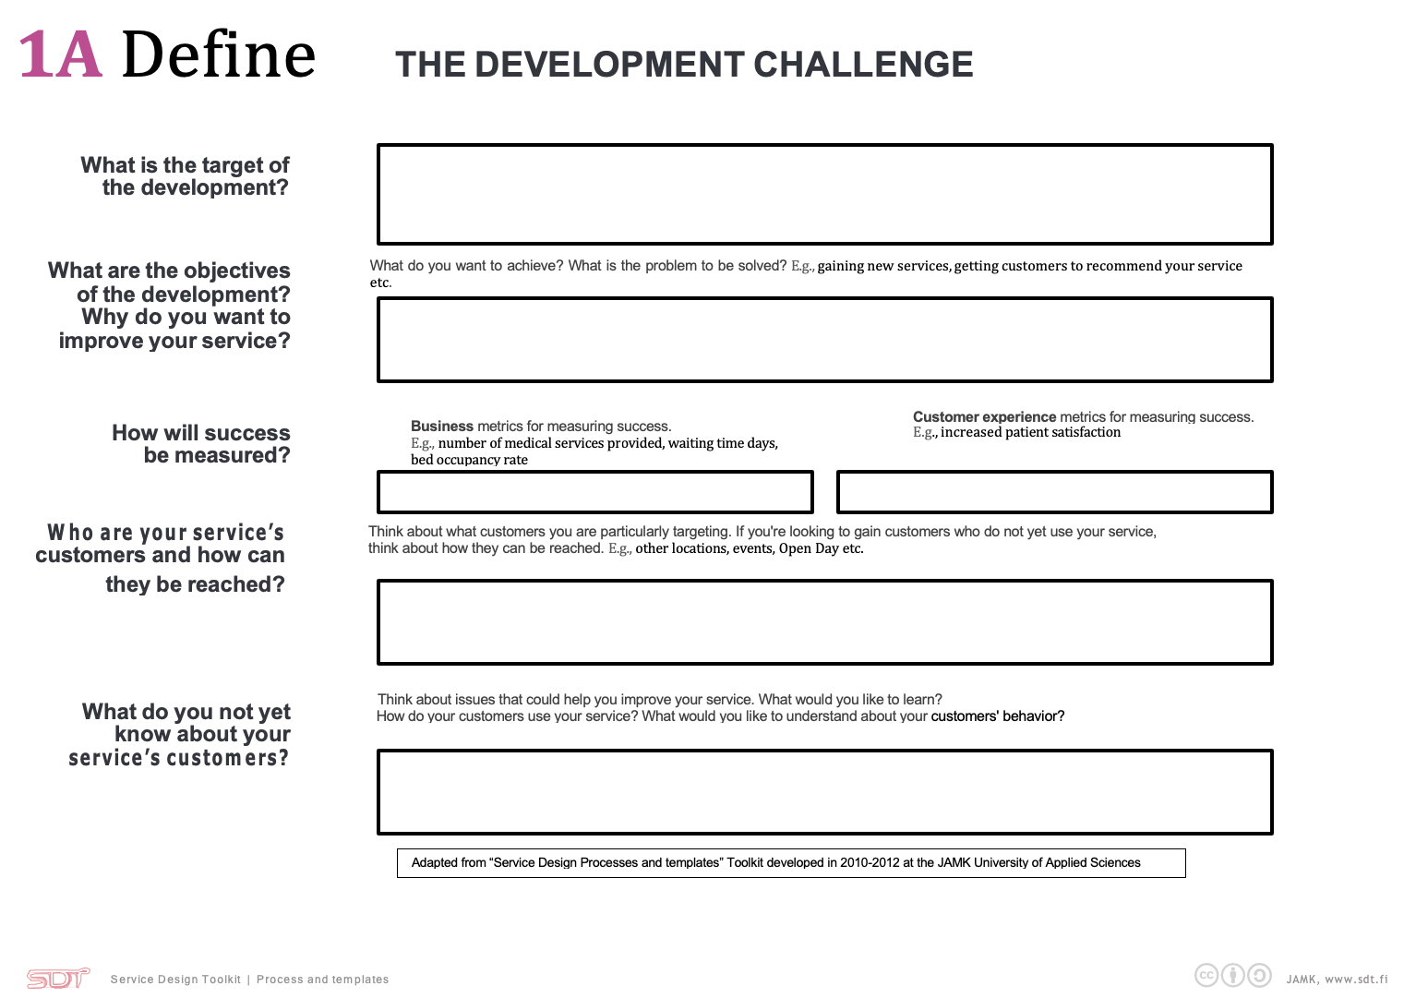
1A. Define: the development challenge
1.A. Define -tool consists of 6 boxes for text.
Box 1 Write in the box one sentence that describes the purpose of the development project.
The next step (box) is to define the goals for your development project. The goals should answer the following questions: What do you want to achieve? What problem needs to be solved?
The third and fourth box is the definition of methods for measuring your success and results, in other words, what indicators will be evidence of the effectiveness and efficiency of improving services.
The fifth box is the identification of your customers. Who are the users of the service, describe them.
The sixth box should contain those issues you that you would want to know about the customer.

Slide 5
1A. Define: the development challenge Example

Slide 6
1B The customer’s service pathway
1B | Draw the customer’s service pathway.
The description of pathway of serving the customer should include each the step which the customer goes through before receiving the services, all the steps during the receipt of services and after the completion of the receipt of services.
All three periods should be described and scheduled for all employers and persons with whom the customer interacts.
In addition, it should be described what a particular person does (whether it is a customer, whether it is the staff with whom he interacts).
Hot spots is the main points which is satisfied or unsatisfied by customers. A particular customer touchpoint or a business activity that can be improved is a hot spot. [2] You should mark them on the customer’s service pathway.
The customer service pathway is used to document what the development group thinks that is the service pathway before shadowing and interviewing.

Slide 7
1B The customer’s service pathway Example

Slide 8
1C Select your tools and design your development project (optional)
Use this tool as material during the workshop to support choosing the questions and information collection methods for your development project.
First, it is needed to list the aims which you want to achieve and then choose the most important one to work on it. Finally , you need to choose the methods for collecting data.

Slide 9
1C Select your tools and design your development project (optional) Example

Slide 10
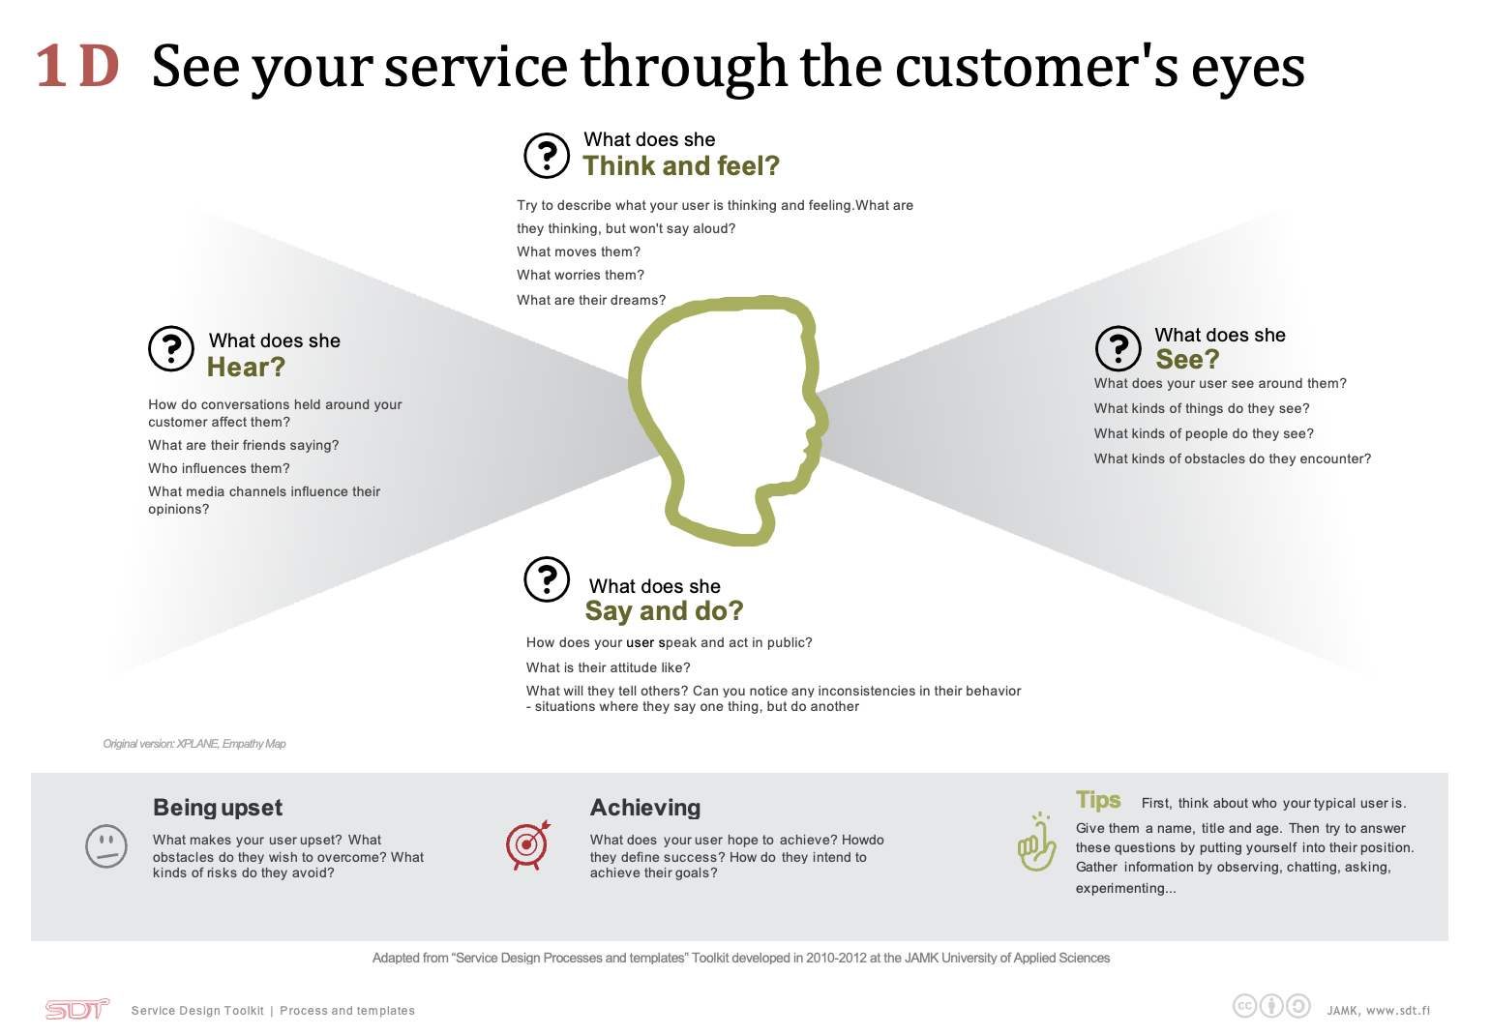
1D See your service trough the customer eyes
This tool will help you understand the service from your customer's point of view. And it will help you understand what your customer wants to achieve and what he is not satisfied with.
First, think about who your typical customer is. Give them a name, title and age. Then try to answer these questions by putting yourself into their position.
Gather information by observing, chatting, asking, experimenting.

Slide 11
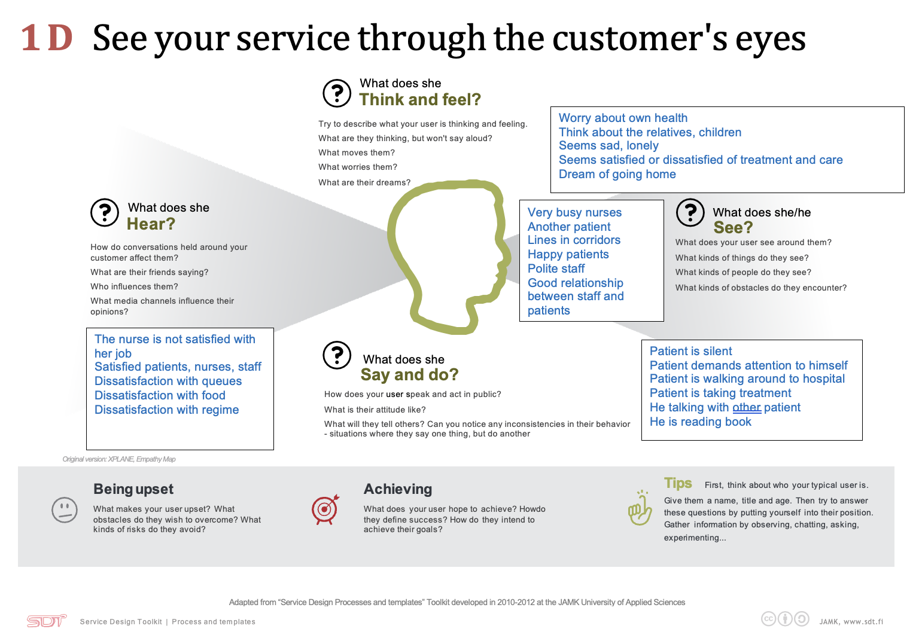
1D See your service trough the customer eyes Example

Slide 12
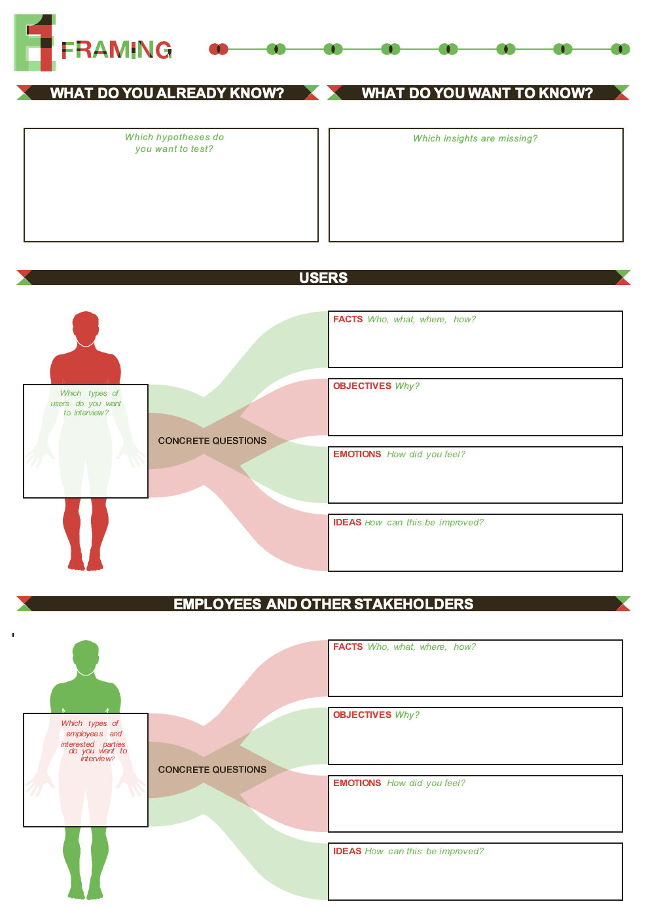
1E Framing.
The purpose of the tool is to help you prepare for interviews and understand the users of the services and service providers ( i.e. nurses, doctors and other stakeholders of the service)).
Box 1. Write those issues in the box that describe what do you already know abut the service from the point of service user and the service providers.
Box 2 Write those issues what you would like to know about existing problems and the opinion of users on solving the problem in the form of QUESTIONS.
Next are the fields related to the service user. You should prepare question for getting deep information concerning FACTS of USER (who are they? What characteristics does they have?), OBJECTIVES (measurable indicators, for example satisfaction), EMOTIONS (feelings and emotions of service users) and IDEAS for solving existing problems and improve services.
Below are the fields related to service providers. Here also need to prepare questions to define the FACTS in them, that is, to determine the service providers: who belongs to them? What characteristics do they have? OBJECTIVES, it is necessary to define the goal of the development project in the form of measurable indicators. Further in the EMOTIONS field, it is necessary to describe the feelings and emotions of service providers. The final field is the formation of IDEAS to improve the quality of services provided.

Slide 13
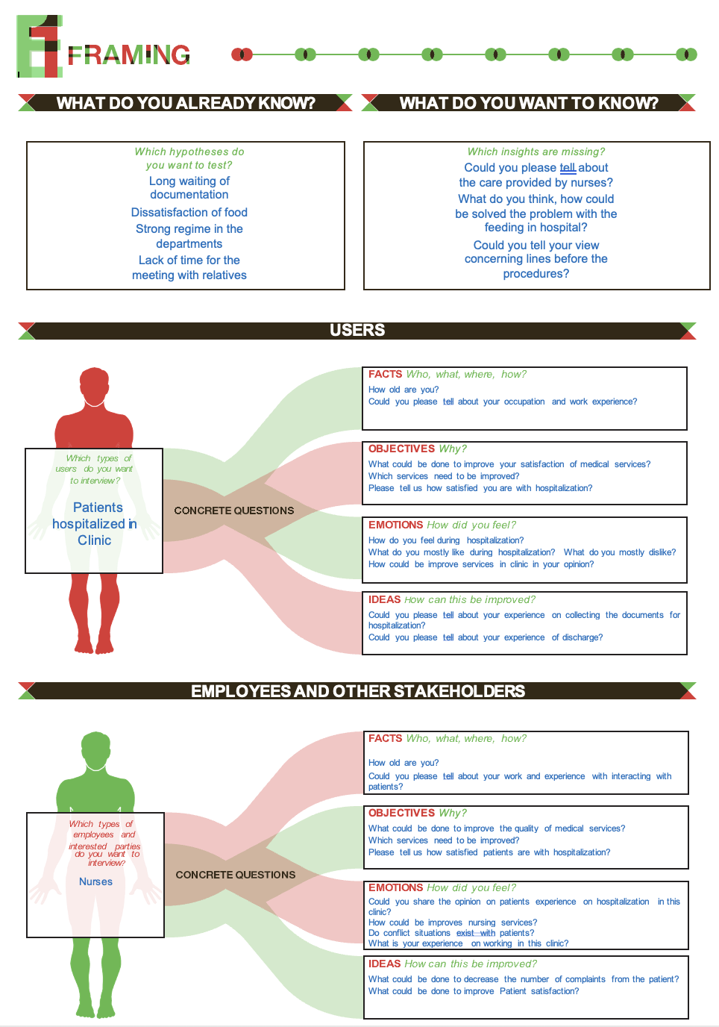
1E Framing. Example

Slide 14
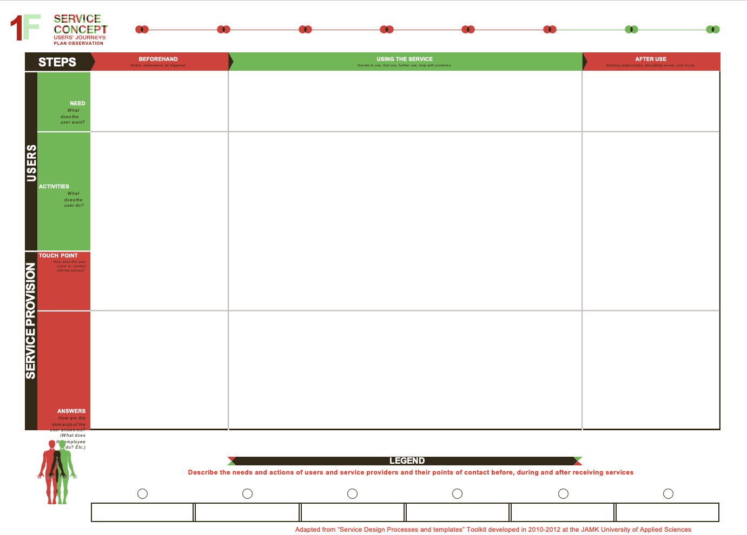
1F User Journey Plan Observation: documentation of user journey during shadowing and interviewing
The 1F tool aims to describe the needs and actions of Service Users /customers and describe the actions of service providers and their points of contact before receiving services, during receiving services and after receiving services.
This tool is filled in during authentic data collection, while making the documentation of shadowing or during interview.
In the bottom you should write short name of touchpoint between the user and service providers.
In the middle of the table, in the “Using the service” you should describe the touchpoints which are on the bottom of the form.

Slide 15
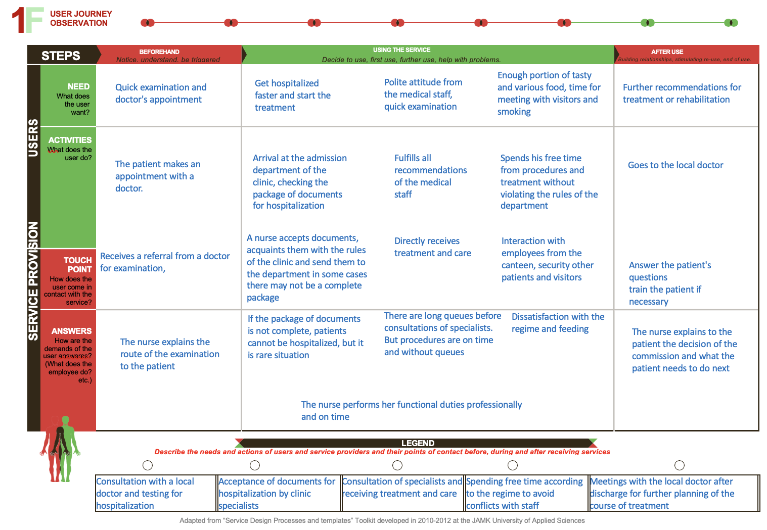
1F User Journey Plan Observation: documentation of user journey during shadowing and interviewing Example

Slide 16
1G Informed consent
Use informed consent before beginning interviews and shadowing. As a contact person, you can specify the leader of your team and his contact details.
Informed consent must be signed in two copies, one copy is given to the patient/nurse, the second remains with you.

Slide 17
2A Empathy map
Empathy map describes what the user:
- said (during an interview),
- did (during surveillance, everything that you managed to capture, write down, remember),
- thought (in your opinion, that is, you saw his facial expressions) and
- felt (that is his reaction to what is happening around him while receiving services).

Slide 18
2A Empathy map Example

Slide 19
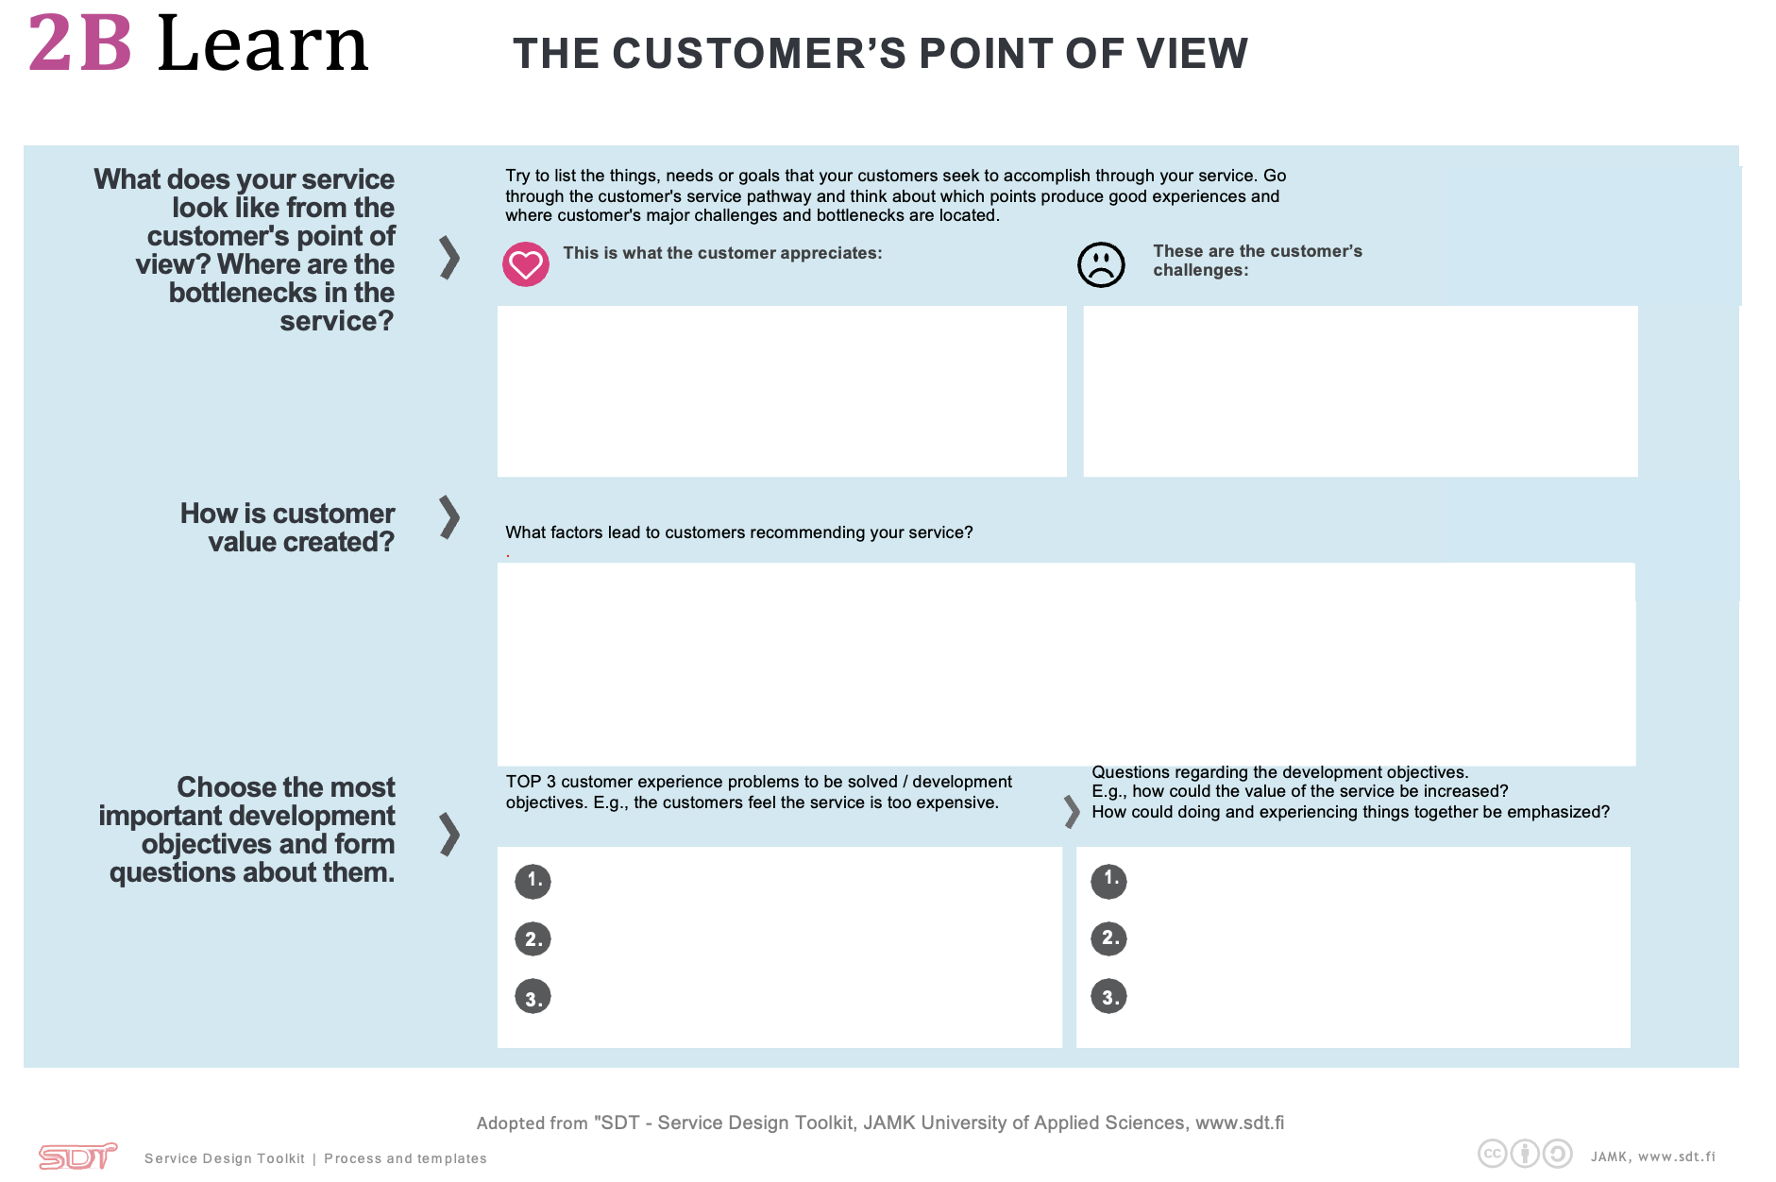
2B The customer point of view
Filling out the form 2B, consists of 3 boxes.
1 box is the definition of those services that the user likes and those services that the user is not satisfied with.
The next stage (box) is the definition of those characteristics that the service should correspond to. Describe what qualities the service should have in order for users to want to receive the service from you.
In the conclusion (box 3), you must select the 3 most important problems that you must solve for the user in improving services and on the right, describe the methods or approaches that can solve this problem.

Slide 20
2B The customer point of view Example

Slide 21
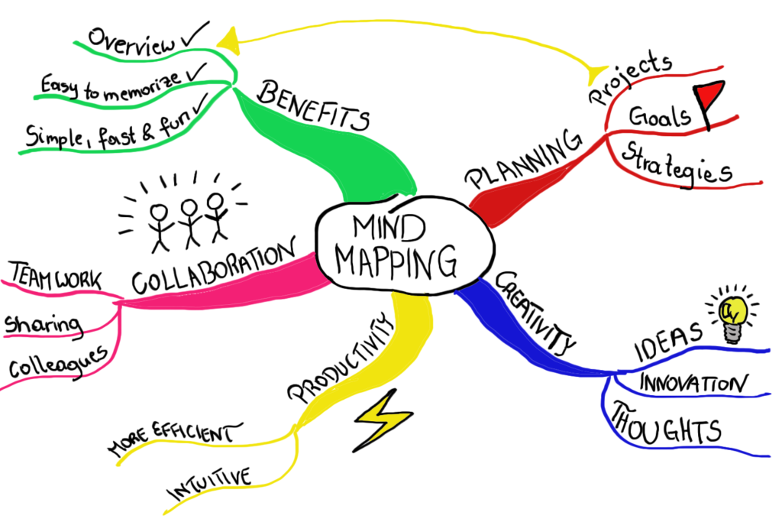
2C Mind map
Use the mind map as a step in problem and solution formulation. To do this, you can use a blank flipchart and markers for a more colorful and understandable description.

Slide 22
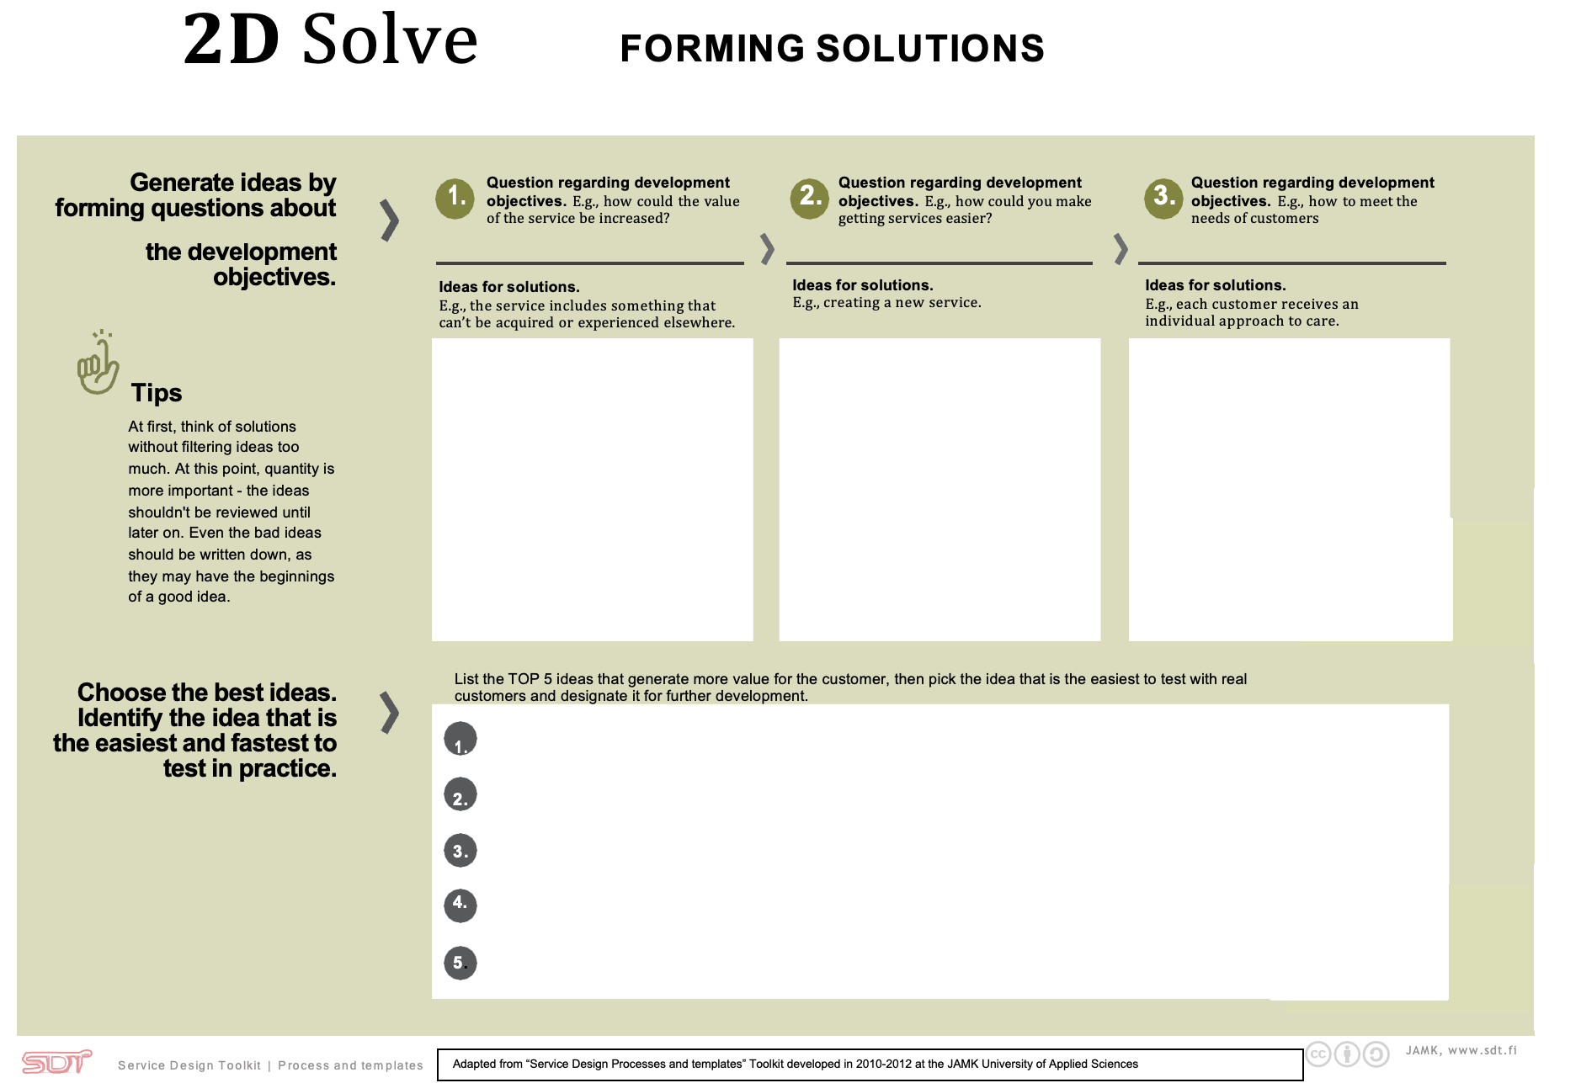
2D Forming solutions
Generate solution ideas based on the tips provided in the tool.
The first three boxes are aimed at identifying initial solution ideas. Generate as many solutions as you can without limiting yourself.
After that, you need to choose the five (5) best ideas among those listed above and fill in the bottom, fourth box.

Slide 23
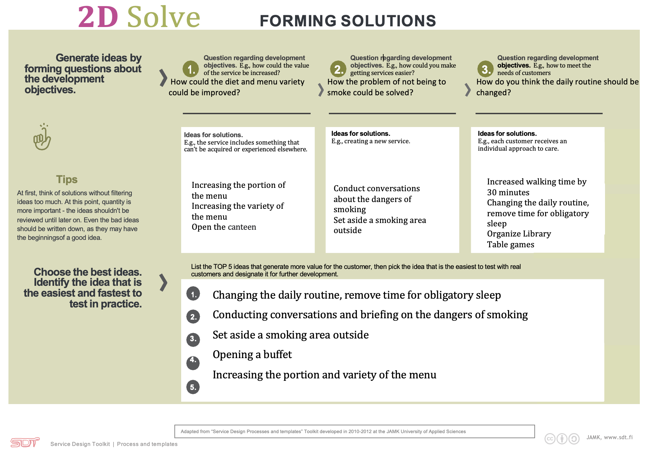
2D Forming solutions Examples

Slide 24
3A USER profiles
This tool will help you prepare your customer USER profiles.
Follow the tips given in the tool for profiling.
Refer to your data from Discovery phase when you interviewed/observed the end users. Try to figure out their behavior using the dimensions for behavioral differences and opposites. Try to identify general behavioral patterns with differences and opposites.
Choose two dimensions that are relevant, common and stands out with your users. And make this cross to each other creating four profiles of users with their behavioral differences and opposites.
Once you created the four opposing profiles, further describe their characteristics using the Personas.

Slide 25
3A USER profiles Example

Slide 26
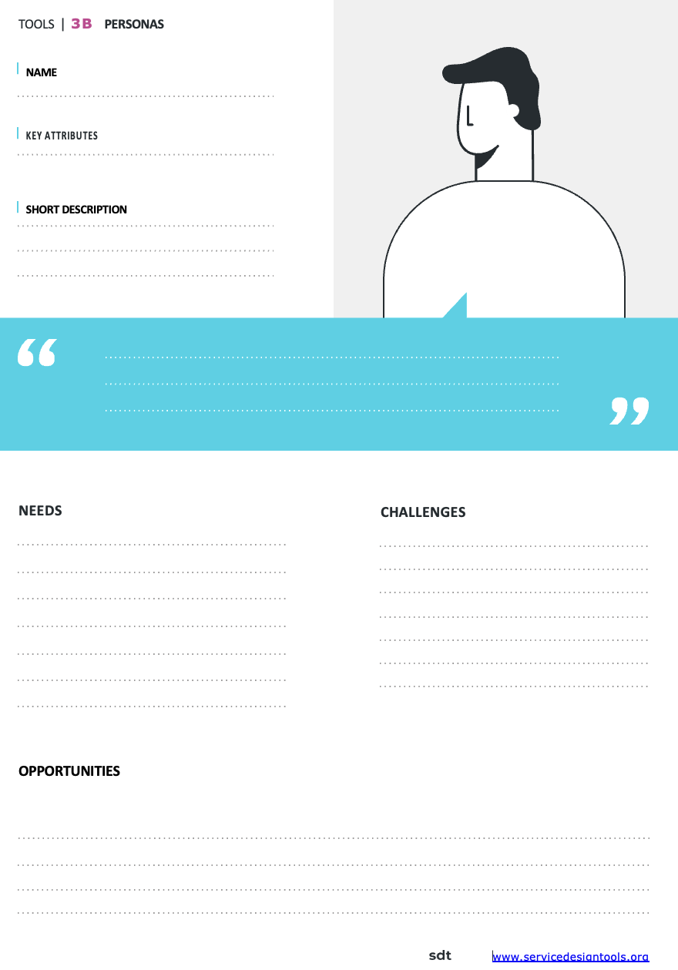
3B Persona template
Use this tool to prepare your user profiles. At least 4 user profiles must be provisioned.
Use pictures and photos from the internet for a more colorful picture.
Key attributes (characteristics), this is the behavior you identified from 3A template.
Short description (how does this vary from key attributes?) this is a statement about the general but specific description on your end-user. For example, Judith, 25 years old, a mother of one, and is currently studying economics in a university.
Opportunities, this refers to the points for improvement. Considering the needs and challenges the points for improvement serve as an area where possible solution will be developed.
Maintain participants’ confidentiality , that is not to use the real name or personal data of the participants from your interviews.

Slide 27
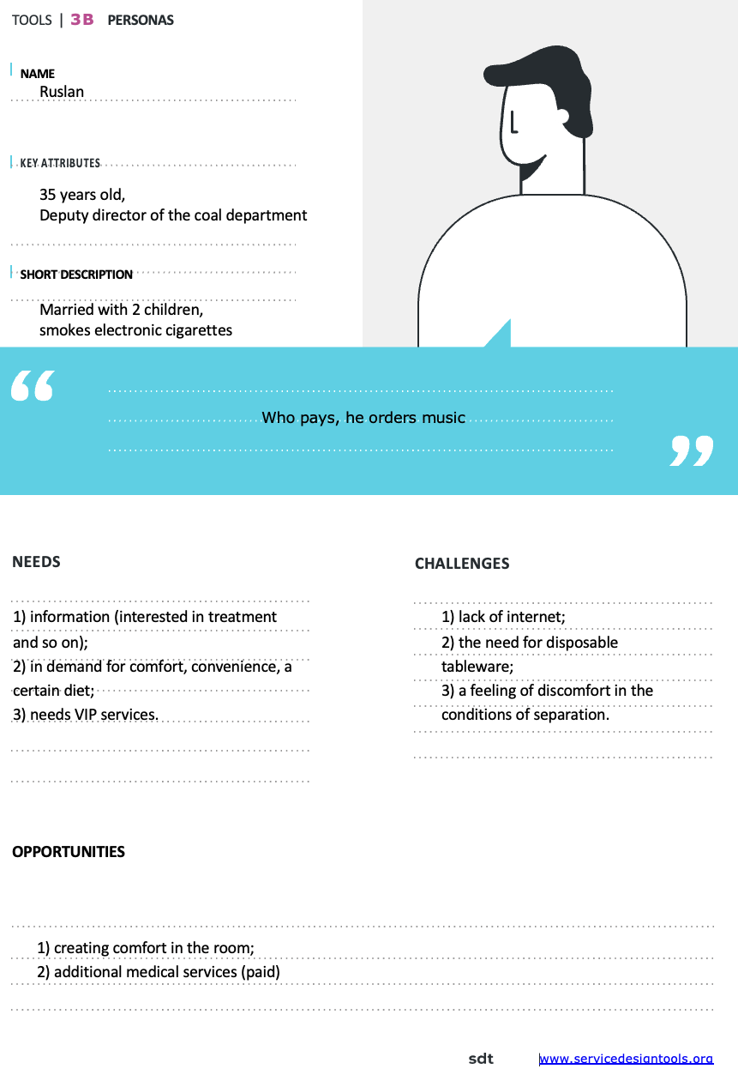
3B Persona template Example

Slide 28
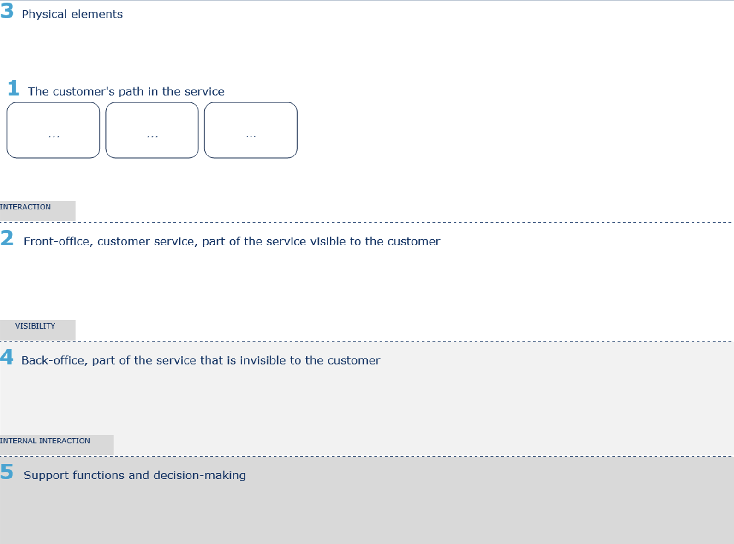
3C Blueprint / Improved Care pathway
To prepare the plan, use blank flipcharts and colored paper to separate the patient's path "before", "during", "after".
You are free to draw, the template on the left is an example.
Or use a template for this.

Slide 29
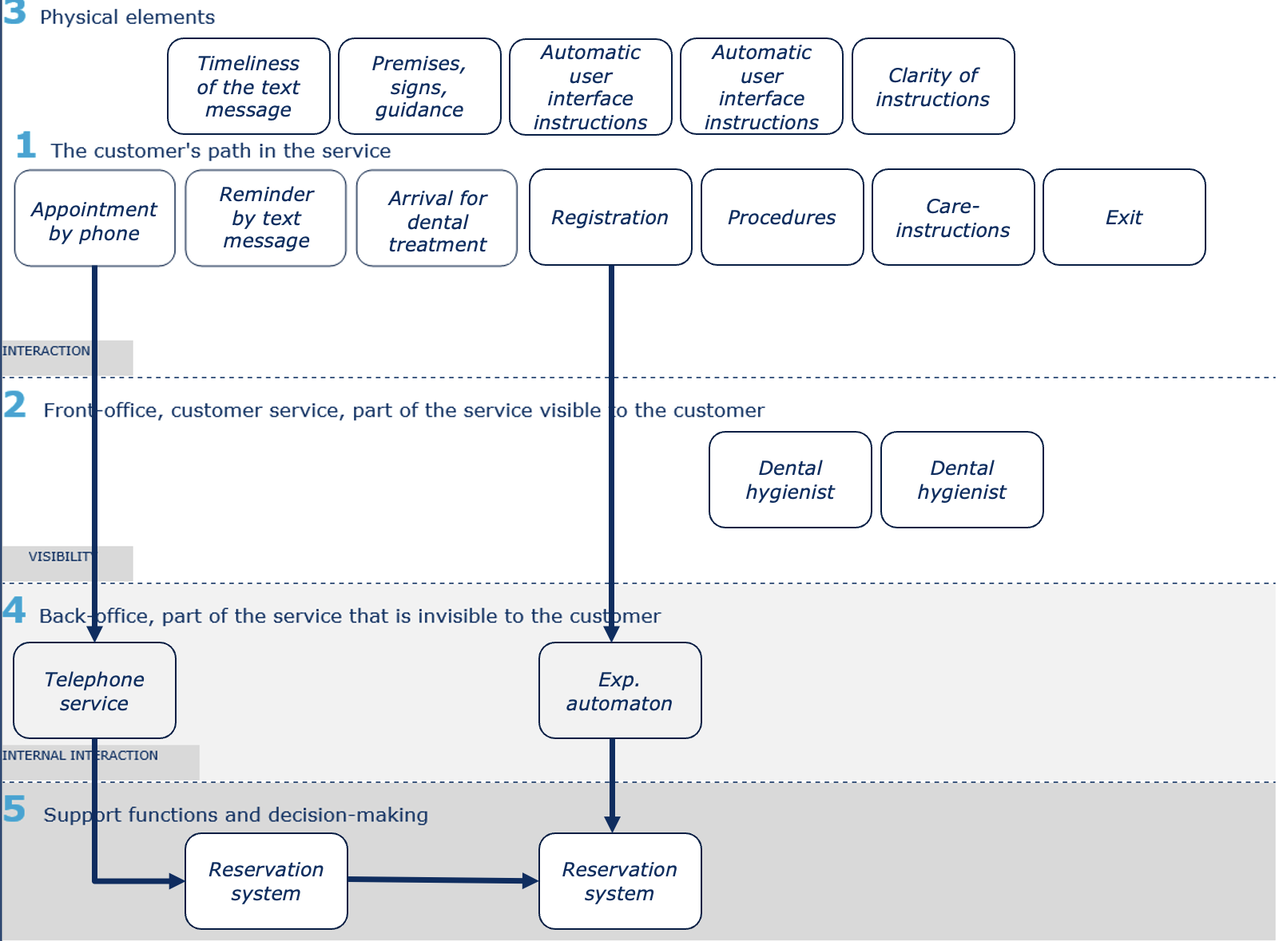
3C Blueprint / Improved Care pathway Example

Slide 30
4A Collect information, improve and productize your service
Now you can test the service with customers. After collecting information from your work using this tool, to improve your service.

Slide 31
4A Collect information, improve and productize your service Example

Slide 32
References
1A, 1B, 1C, 1D, 1G, 2B, 2C, 2D, 3A, 3C, 4A - SDT - Service Design Toolkit, JAMK University of Applied Sciences, www.sdt.fi
What are hotspots? https://www.liveworkstudio.com/articles/identify-customer-and-business-hotspots/
2A Empathy map, 3B Persona template - www.servicedesigntools.org
1E Framing. Research questions, 1F User Journey Plan Observation: shadowing user journey for shadowing and interviewing - https://www.servicedesigntoolkit.org/downloads.html

